Slide 1
Welcome to the Fall 2013 CLA Senior Celebration!

Slide 2
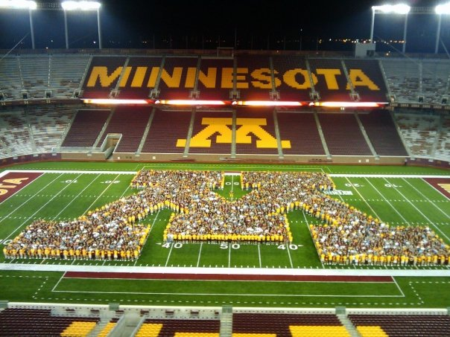

Slide 3
Congratulations on your perseverance and success! The world seems more challenging now than ever, but the truth is, it's always challenging when you first emerge on the scene, degree in hand. Remember, what you choose to do first may not be where you will ultimately "last", but it will shape each subsequent decision you make, so embrace each challenge and work hard.
– Dan Williams ‘84 Speech and Mass Communication

Slide 4
Matthew Kenneth Abdo BA Journalism BA Communication Studies Best 7 years of my life.

Slide 5
Tselote Abebe BA Asian Languages & Literature

Slide 6
Chloe Lorena Ahlf
BA Communication Studies

Slide 7
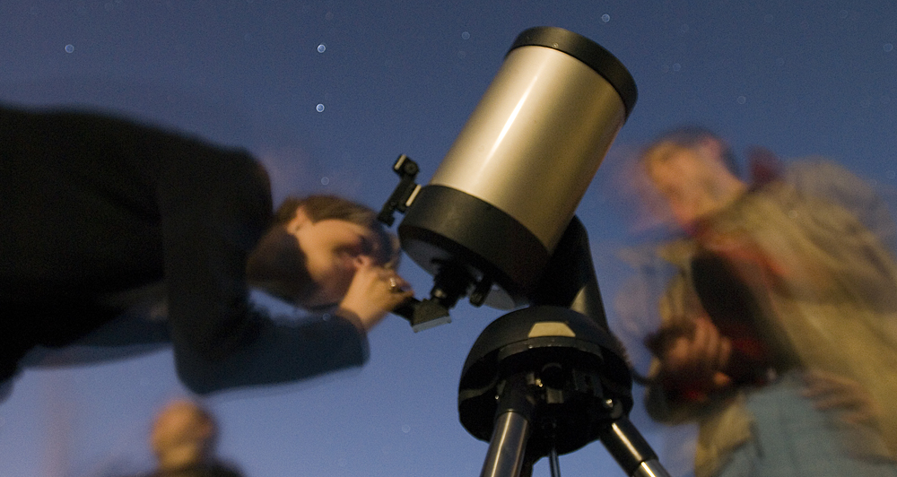

Slide 8
Congratulations seniors! My hope is that you won't be afraid to get your hands dirty and follow your heart, because this is where the adventure really starts!
– Carolina '08 Spanish Studies

Slide 9
Sarah Rose Asche
BA Biology, Society, & Environment

Slide 10
Kristina Marie Astleford BA Physiology

Slide 11
Allison Rose Atkins BA Journalism Mom you are my rock, I couldn't have done it without you. Dad I know you are watching, I hope you are proud. Thanks family for the support.

Slide 12
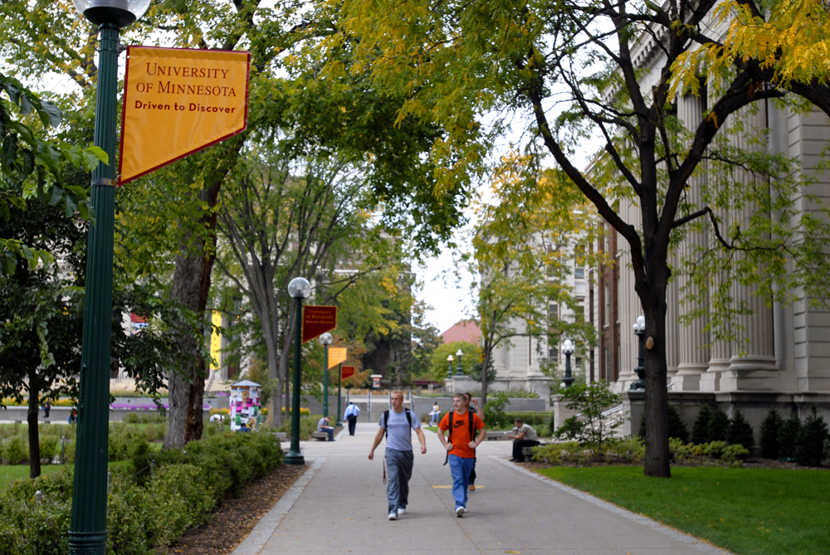

Slide 13
Remember to not put too much pressure on yourself and go with the flow. If your first job is not what you anticipated or not necessarily in tune with your major, be patient. Change can be good, especially over time. Enjoy the fact that you are young and capable of so many things! Think of life as an adventure and know that you are often your harshest critic.
– Jan Bobrowske '72 Spanish

Slide 14
Benjamin Bernard Becker BA Physiology

Slide 15
Janice Marie Bitters
BA Journalism

Slide 16
Brett John Brockel BA Biology, Society, & Environment Thanks Mom & Dad, I couldn't of done it without you!

Slide 18
May your desire to learn be a cup that never empties.
– Kathryn Black Kohn ’03 Psychology

Slide 19
Matthew Wallner Brostrom BA Biology, Society, & Environment

Slide 20
Taylor Duncan Budde BA German, Scandinavian & Dutch

Slide 21
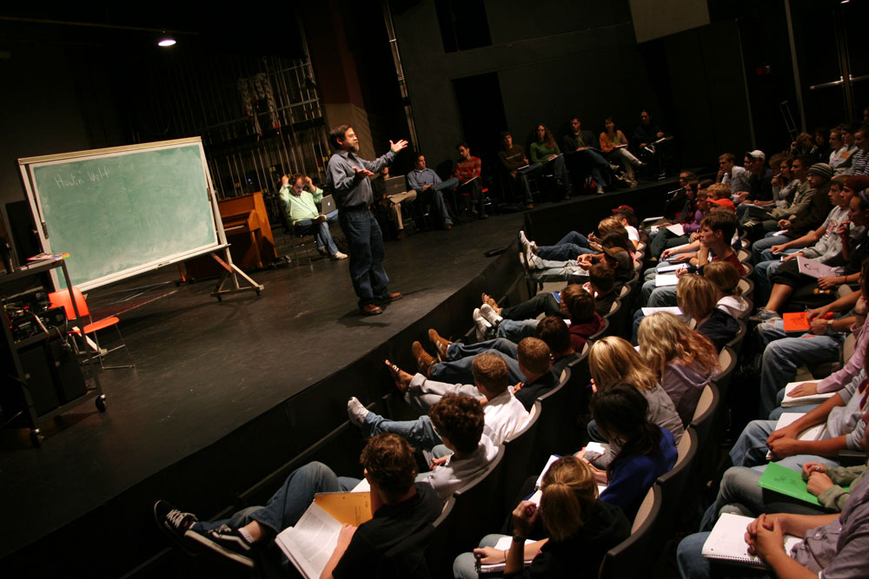

Slide 22
Be ready to try challenges that appear in your life. Whether you succeed in them or not, you'll gain attitude and confidence to proceed along many paths in life.
– Dick (Tiger) Sherman '58 Journalism

Slide 23
Caitlin Elizabeth Cardinal
BA Spanish Studies
Mom, Dad, Chloe and Jack, Thank you for all your support! I wouldn't be here without your love and encouragement. I love you so much!

Slide 24
Jiecao Chen BA Mathematics

Slide 25
Minyoung Choi BA Communication Studies

Slide 26
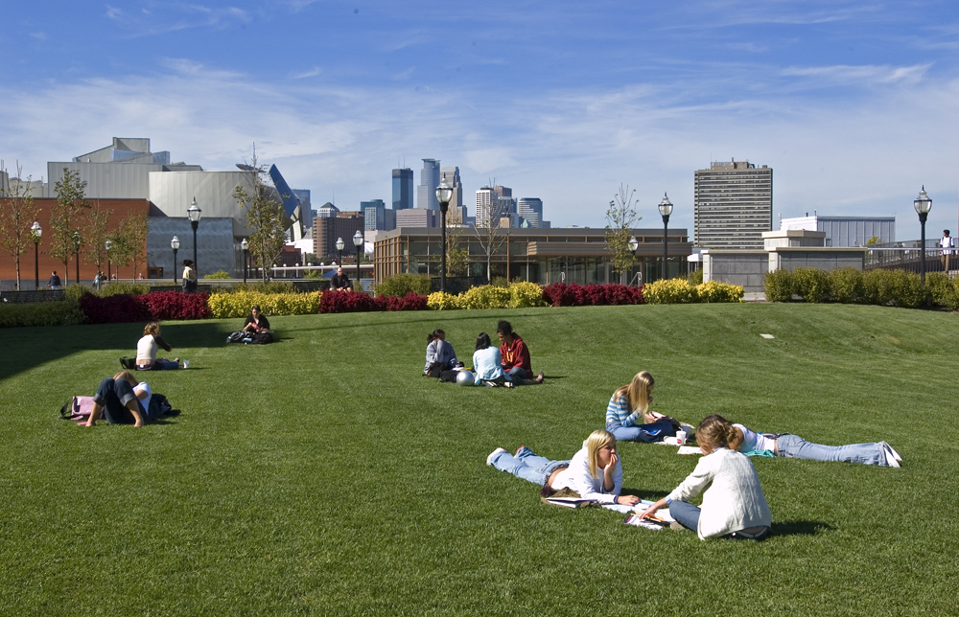

Slide 27
The U of M and Gophers in general are connected across the world. Stay connected. You will need help along the way and others will need your help. Know that a fellow Gopher is willing to give you a chance, help you or give advice. You will have your turn to "pay it forward" to a fellow Gopher, and see the joy, in kindness at work. Stand proud aside decades of proud Gophers!
– Martha Hoover ’84 Business, Economics

Slide 28
Hu Ting Chu BA Communication Studies

Slide 29
Morgan L. Collins
BA Journalism

Slide 30
Justine Claire Dieringer BA Communication Studies

Slide 31
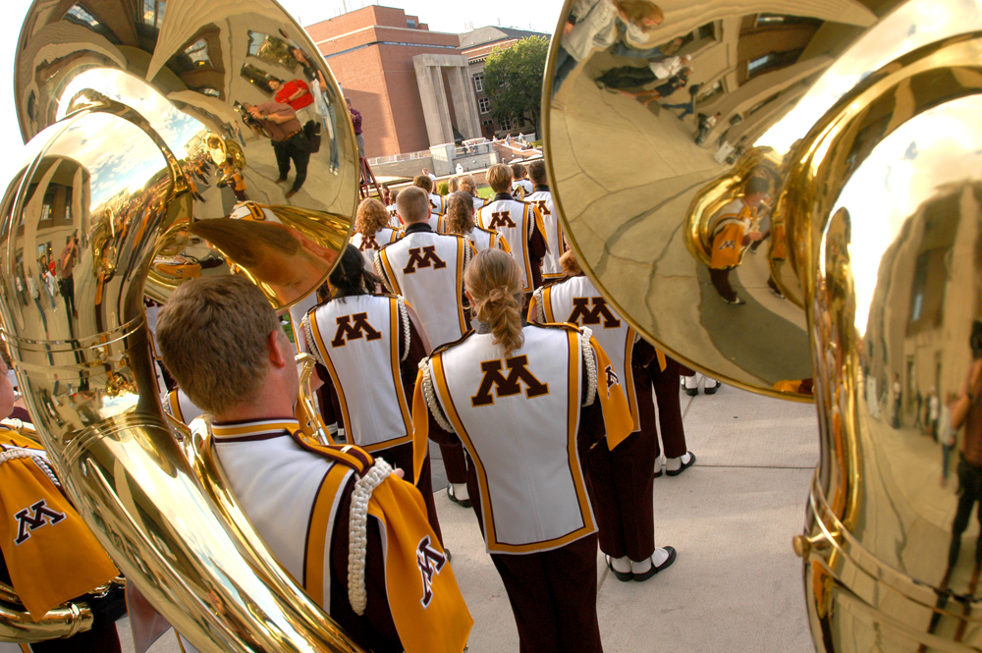

Slide 32
Set your goals high, stay focused, consider positive advice, work hard, and most importantly believe in yourself and what you want to do, and do it!
– Roma Calatayud-Stocks B.A. ‘87

Slide 33
Kelly Jean Atherton Doering BA Communication Studies Thank you Mom and Dad for forcing me to do this on my own and believing in me. My sense of accomplishment is greater because of it.

Slide 34
Natalia M. Espana
BA Spanish Studies

Slide 35
Nicole Pearl Ewald
BA Communication Studies
Mom, Dad & Zach, thanks for having faith in me when I didn't have faith in myself. I could never have done this without you. I love you all!

Slide 36
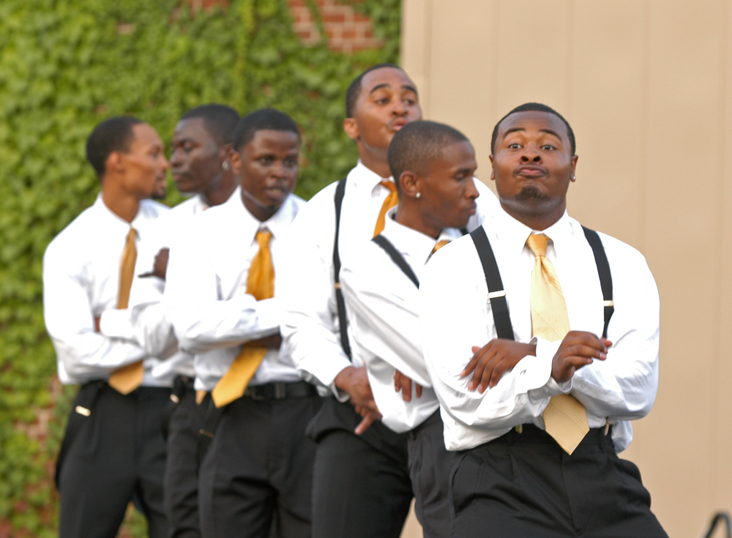

Slide 37
An anonymous quote – have no idea of the source –but I live by it and always teach it to others: Teach thy tongue to say "I do not know", and thou shalt progress.
– Mary Maguire Lerman ‘74 Spanish and Portuguese

Slide 38
Daniel Brendon Fitzsimmons BA Mathematics

Slide 39
Stephanie Aurelia Foote BA Chicano-Latino Studies Thanks to all who have helped on this Journey... Dad, Mom, my Sisters and Brother, Nate, and my Donovan and Aurelia for being my reason!

Slide 40
Marcheta A. Fornoff BA Journalism summa cum laude

Slide 41
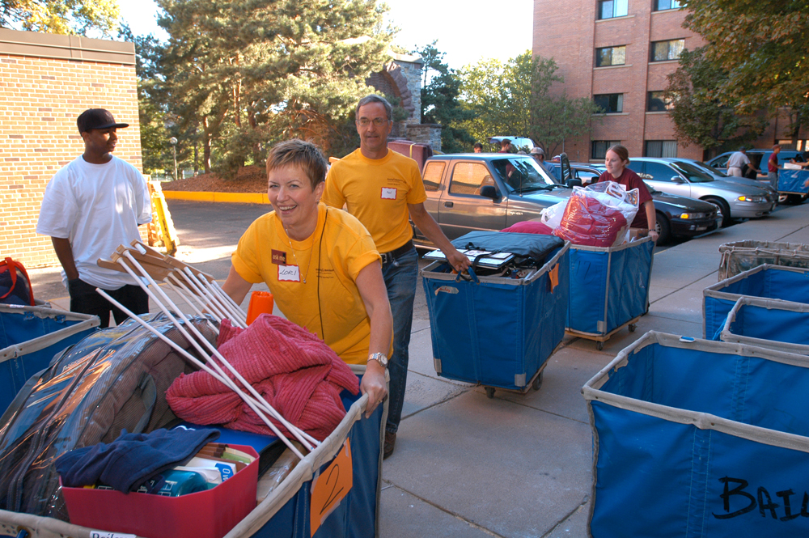

Slide 42
Follow through with whatever you set out to do. A college degree is merely a launching pad...think outside of the box and do good to others treating them as you would like to be treated.
– Sandra Myklebust ‘74 Social Welfare

Slide 43
Charlie W. Fox BA Biology, Society, & Environment

Slide 44
Shira Masha Frishman BA Communication Studies

Slide 45
Rebecca Sue Gerhardt
BA Spanish Studies

Slide 46
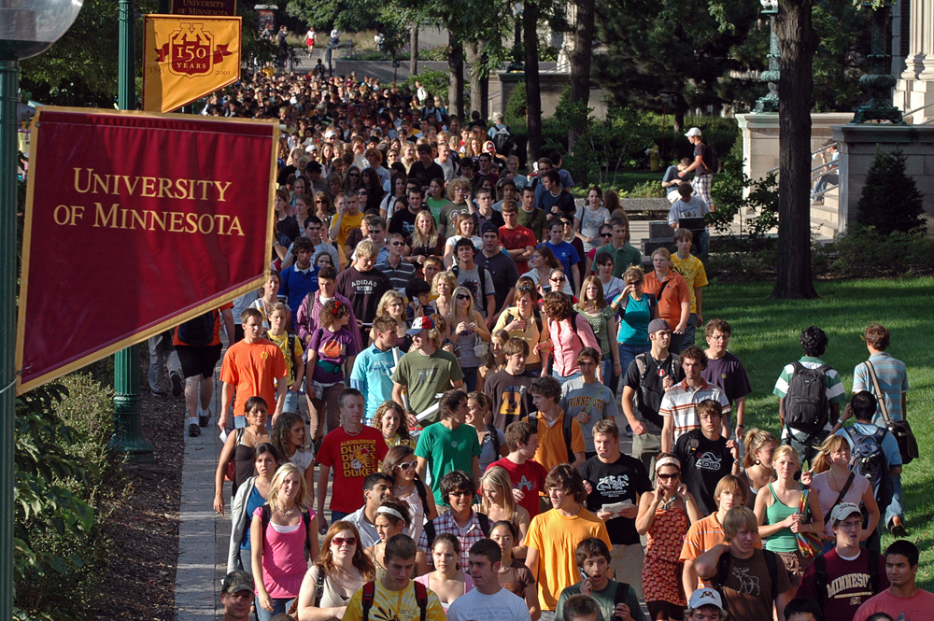

Slide 47
Be willing every day to stretch yourself, to try new things, even if you have already convinced yourself you cannot do something, because every failure is really a success, if you learn from it.
– Al Benson ‘70 Economics, Journalism

Slide 48
Alexandra E. Golie BA Spanish Studies Distinction

Slide 49
Megan J. Gosch BA Journalism BA Global Studies

Slide 50
Ellen Renae Groen
BA Biology, Society, & Environment

Slide 51
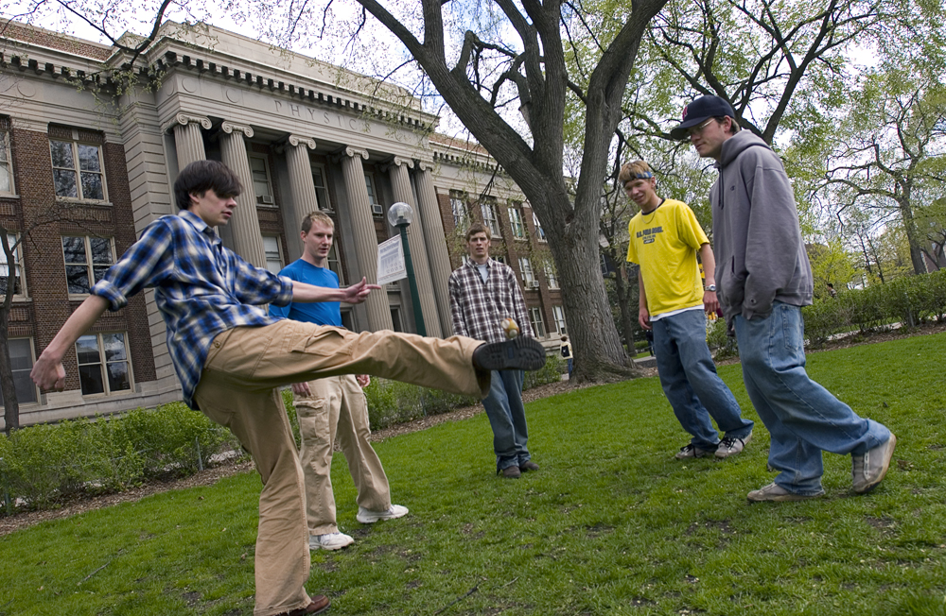

Slide 52
My father has shared this with me at times when I was facing a tough situation – "Every project looks like a failure from the middle.”
– Tom Klas International Relations

Slide 53
Hannibal Jaxson Whitney Guelich
BA Communication Studies

Slide 54
Jigar Robert Brown BA Biology, Society, & Environment Going to the U of M has been one of the biggest life-changing events I've experienced. I learned a lot about myself and have grown as well.

Slide 55
Zixiao Han BA Computer Science

Slide 56
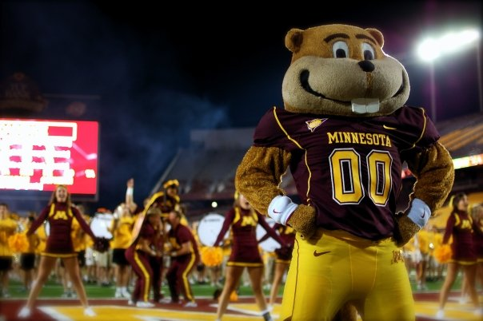

Slide 57
Remember the U of M as you make your way through life’s journey and think of those on campus who made your years at the U meaningful and worthwhile ones. When the pleas for funds come, open your hearts, minds and wallets. Here's to the adventures that await you.
– Larry Gold ’64 Political Science

Slide 58
Jeffrey Allan Hargarten BA Journalism

Slide 59
Dane William Heig BA Communication Studies

Slide 60
John-Michael Henry Hessler
BA Communication Studies
Congrats to all of the grads receiving their diploma! Thanks to everyone who has supported me on my journey! Thank you for everything dad!!!

Slide 61
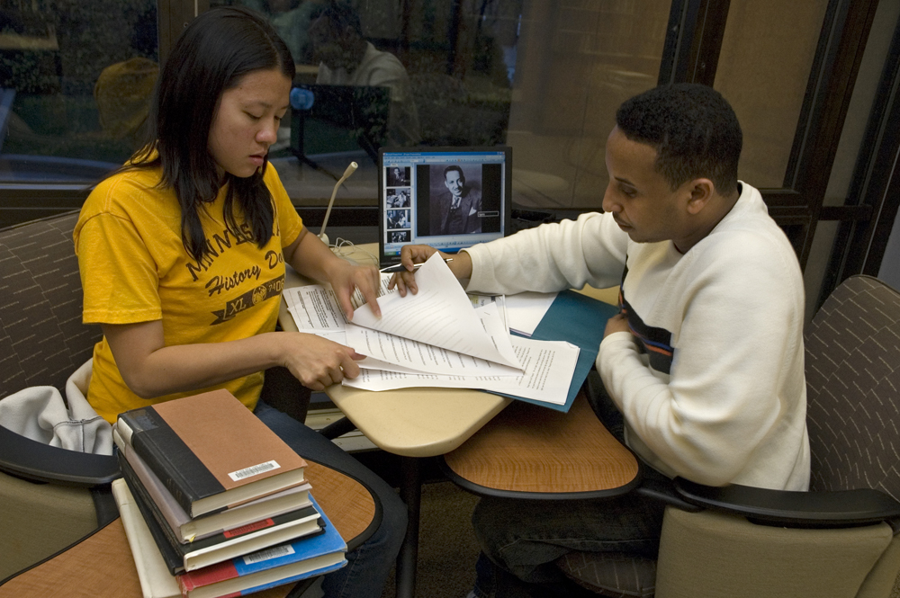

Slide 62
I have more and more come to the conclusion that to take advantage of an education, we need to become well rounded and critical and informed thinkers in many areas. In a democracy people need to know about a great deal relating to our culture and those of the whole world historically. Don't just be a robot, be a whole human being.
– Mark Walsh ‘90 Philosophy

Slide 63
Madisyn Rae Hilborn
BA Communication Studies

Slide 64
David Henry Humphrey BA Linguistics

Slide 65
Megumi Anne Iwasaki
BA Spanish Studies Congratulations to the class of 2013!

Slide 67
Be appreciative of the opportunities afforded to you at this wonderful institution. Its history...past and present...are special.
You are a part of the family of CLA. Be proud of that heritage.
– Kathryn Anderson '66 Sociology

Slide 68
Nafiz Jaidye
BA Physics
Congratulations to the class of 2013!

Slide 69
Stephanie Ann Kalmon
BA Asian Languages & Literature
Thank you so much to my husband, our families and UMN's ALL dept. for the incredible support in reaching my academic and career goals!!

Slide 70
Anna Lalia Kamsin BA Physiology Congratulations and great job to all seniors! Thank you Mom for all your support!

Slide 71
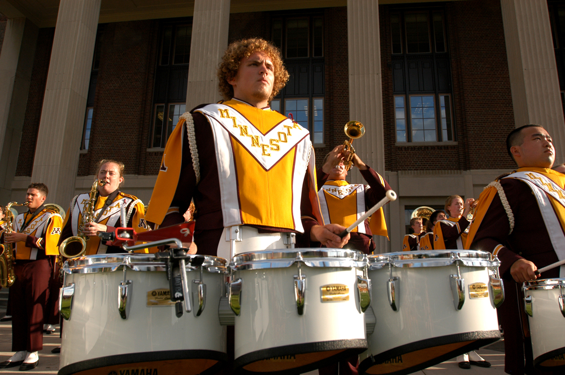

Slide 72
Cherish the unexpected – seek it out! You will then find the value of a liberal arts education.
– Mike Dardis
History, Geography, Business

Slide 73
Eric Zachary Karn
BA Mathematics
I couldn't have done it without my family. Glad I kept my eyes on the prize.

Slide 74
Lauren Yon-Soo Kim BA Global Studies High Distinction summa cum laude Thanks Dad and Mom for all the support not only financial but also emotional one! Thanks friends for being there. I Love you so much!

Slide 75
SangAh Kim
BA Communication Studies

Slide 76
Ryan Michael Kosek BA Biology, Society, & Environment Thanks Mom and Dad!

Slide 77
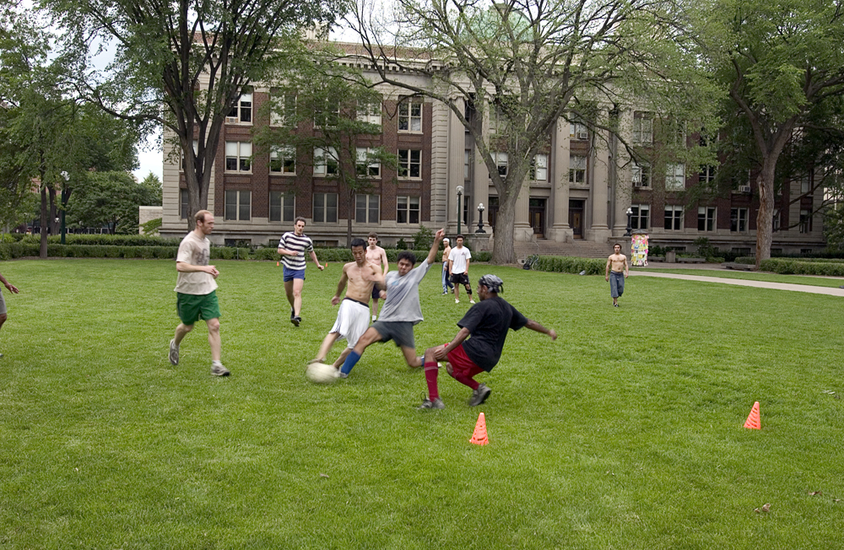

Slide 78
Remember...it is not only about what you've learned while in college but also who you've become – as a friend, a citizen of the world, and, most of all, as a person. Be the best you can be, follow your passion, and be kind to yourself and others.
– Mary Melbo
'72 Psychology

Slide 79
David Roberts Kraft
BA Communication Studies
I'm grateful to have the support of friends and family as I move onto new horizons! My thanks also go out to faculty that believed in me!

Slide 80
Laura Elizabeth Kreft BA Communication Studies A big "Thank You" to my beautiful mother for making everything possible in my life!

Slide 81
Taylor Marie Kuchera
BA Communication Studies
Congratulations, Gophers!!

Slide 82
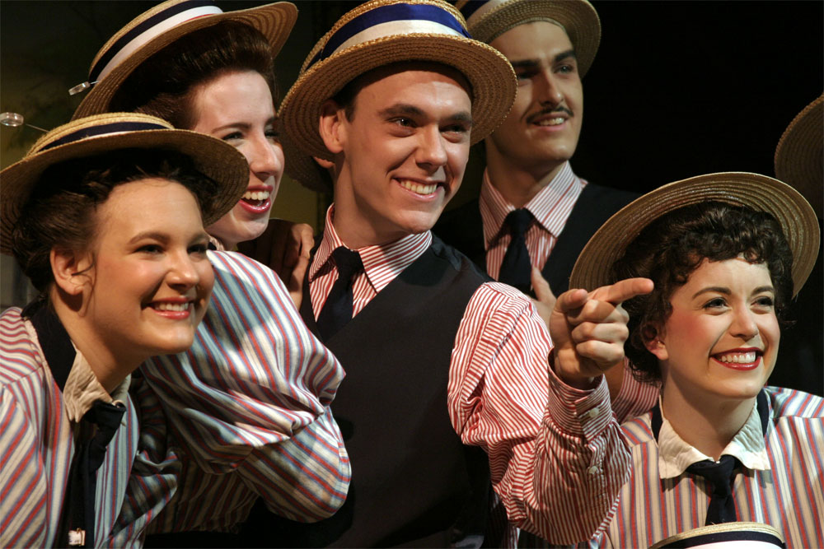

Slide 83
At the end of every day, even if it's been difficult, stop and think of ten things you are grateful for. They can be as small as someone smiling at you or as big as landing a new job. Having gratitude makes life much happier.
– Consuello Smith
B.A. ‘59

Slide 84
Ezra Efome Kwame BA Biology, Society, & Environment Thanks Mom, Dad, Wayne, all family members and Rhea. Onto more Heavenly Ventures. Amen. To God be the glory and honor and praise... MD

Slide 85
Stacie Marie La Pinske BA Physiology Thank you to everyone for their support and encouragement! A special thank you to my parents Jeff LaPinske, and Lori and Jeff Olson.

Slide 86
Kayla Margarethe Langen
BA Communication Studies

Slide 87
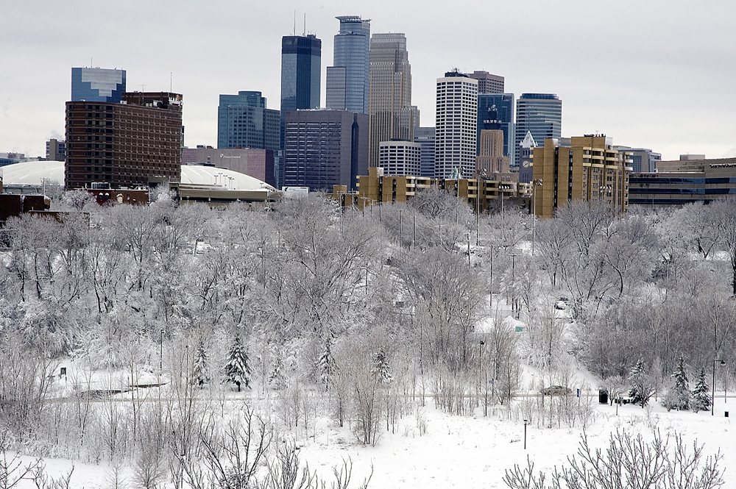

Slide 88
You've done something remarkable - you've graduated with a degree from the College of Liberal Arts at the University of Minnesota. No matter what other amazing things you do in your life, and there will be others, this spectacular, incredible achievement should fill you with pride. Congratulations!
– Nanette Hanks
‘88 Humanities, Art History

Slide 89
Samantha T. Lentsch BA Communication Studies

Slide 90
Mai Nhia Lor BA Mathematics Congratulations graduates! Now it's time for us to change the world! Thanks to my family, friends, and professors for the love and support.

Slide 91
Lindsey Jean Machtemes BA Journalism

Slide 92
Tyler T. Marchiniak BA Physiology Congratulations class of 2013! Best of luck to all of you in your futures!

Slide 93
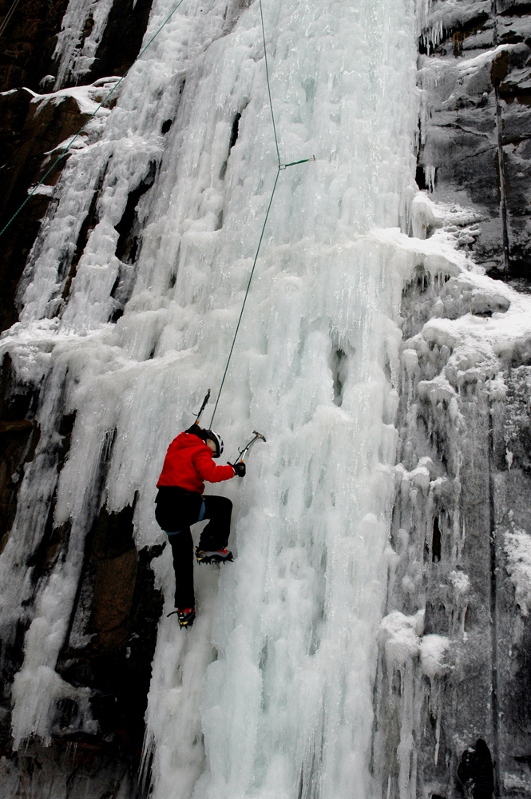

Slide 94
Do your best. Love what you do. Love yourself. Look and listen. Be strong. Be forgiving. Respect yourself. Respect others. Create. Stand up for others. Take care of children. Stay curious. Learn new things. Read. Slow down sometimes. Protect nature. Grow things. Keep an open mind. Be honest. Set goals. Believe in a higher power. Have fun. Teach what you know. Be generous. Learn from the past and be excited for the future. Never cheat. Help with the work. Remember birthdays. Take responsibility for your actions. Laugh a lot.
– Karen Davidson
‘97 Art History

Slide 95
Nicole Enid Mariani BA Biology, Society & Environment

Slide 96
Kevin Armel Martin
BA Communication Studies
Congratulations to everyone for achieving a significant step towards our dreams! I appreciate all those who helped me make this possible.

Slide 97
Vishakha Mathur BA Journalism BA Communication Studies We couldn't have done it without the constant support from our families, friends, & educators who truly inspired us to be our best! CONGRATULATIONS!

Slide 98
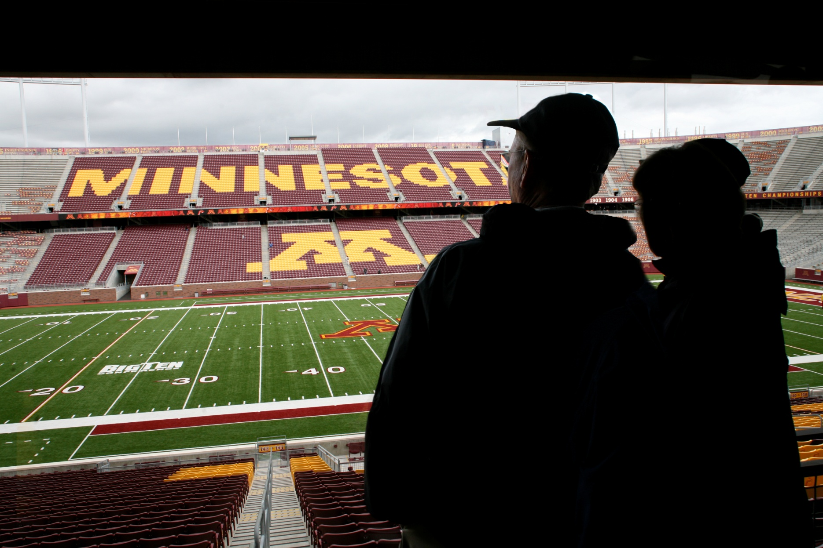

Slide 99
Don't be afraid of the future or yearn for the past. Be ready to go a direction or place (including continent) you weren't planning. It's usually the opportunities you weren't prepared for that turns out to be the most fun and rewarding.
– Ashley Halbach
'10 Journalism, Theater

Slide 100
Thomas Wilson McCoy
BA Russian
BA Political Science

Slide 101
Hope Christiana McCullough BA Journalism Distinction

Slide 102
Arber Meko BA Communication Studies

Slide 104
Here's to you, graduates true. Your road, no doubt, was long...you, however, remained strong! And now a bright new world is opened to you!
– Corey Kellett
'99 Public Relations

Slide 105
Courtney Lynn Mielke
BA Spanish Studies
Thank you to my amazing family for always supporting me in everything that I do! I love you! ¡Los amo muchísimo!

Slide 106
Eric Mueller BA Journalism Thanks Mom, Dad and Jess for supporting me on my adventure as a Golden Gopher. I love you guys. We did it!!

Slide 107
Emily Neighbors BA French Studies

Slide 108
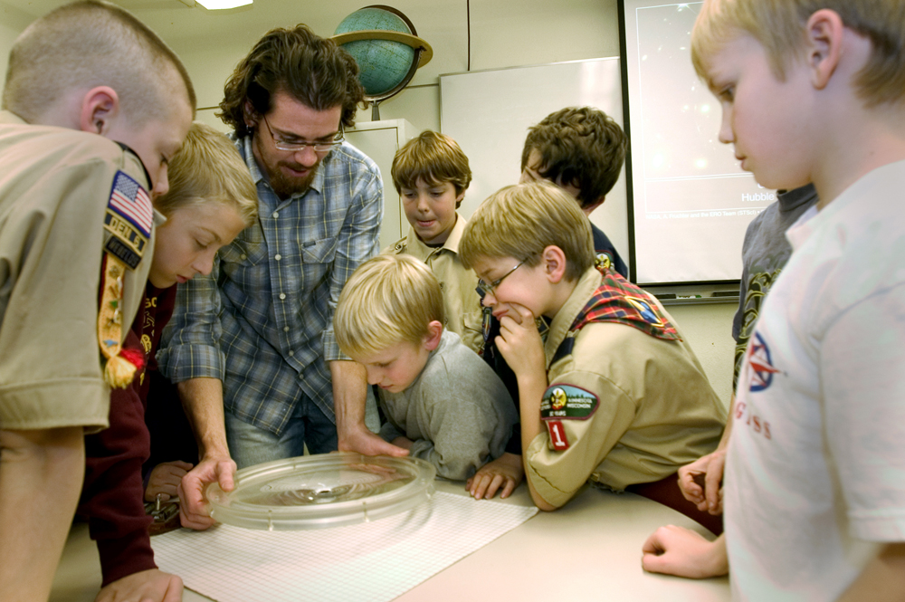

Slide 109
Remember its your attitude not your aptitude that determines your altitude in life.
– Mario Casa de Calvo
‘74 Communications

Slide 110
Rachel Maria Nelson
BA Communication Studies
Congratulations!

Slide 111
Katlyn Mary Nelson BA Biology, Society, & Environment Thank you Mom and Dad for getting me to where I am today. I am so thankful for this journey and excited for what lies ahead.

Slide 112
Caophi Nguyen BA Communication Studies

Slide 113
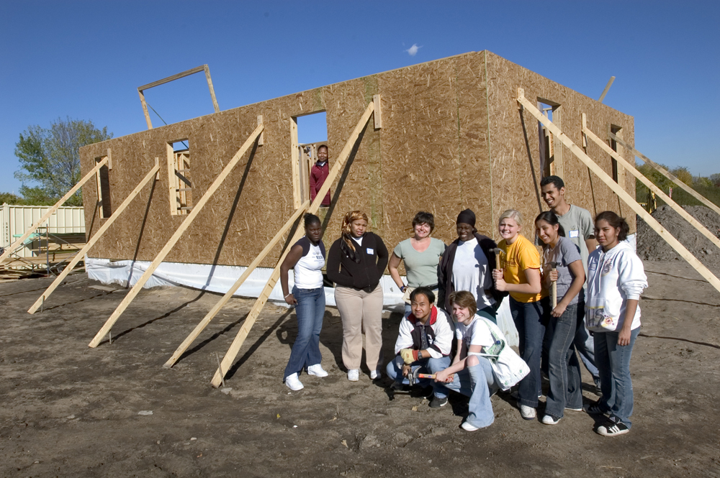

Slide 114
Congratulations! You did it! Never forget this moment or the opportunity you had to receive such an incredible education. Get out there and do something great! Continue to make the University of Minnesota proud!
– Abby Geraets
'09 Architecture

Slide 115
Brian P. Nguyen BA Computer Science To the sleepless nights and endless coffee cups, congratulations to all the graduates of 2013!

Slide 116
Saif Rahman Nizhor BA Physiology Mom, Dad, Bushra, Abhi Bhaia, Nafiz, Ishtiaque, Rokib, Rafat, Sadaf, Sadman, Zafir, Sharmin and Afrin-This one is for you all! Congrats Mighty M'13!

Slide 117
Francisca G. Odozi BA Communication Studies This battle has been won (FINALLY) Now on to the next one. =)

Slide 118
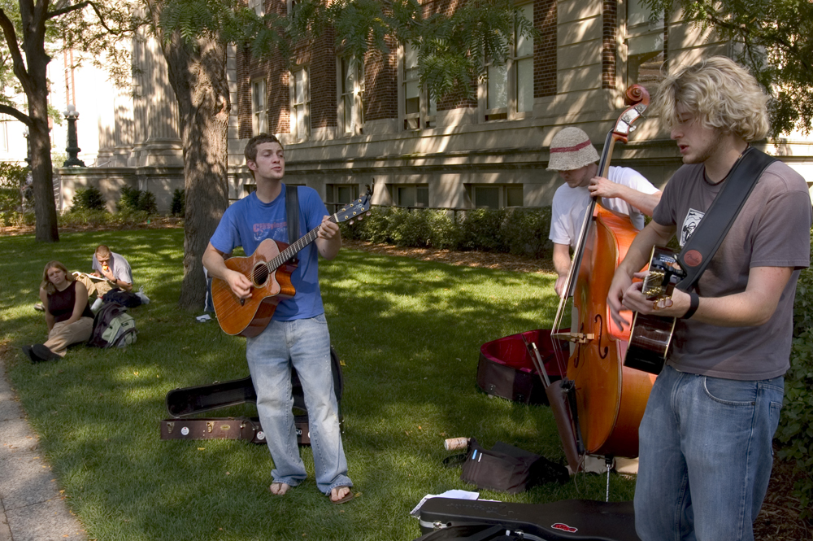

Slide 119
Keep your chin up and your nose to the grindstone. If you can figure out how to accomplish these two things at once, you'll at least find a job as a contortionist.
– Clark Hauschildt
'98 Geography

Slide 120
Holly Lynn Olson
BA Communication Studies
All the hard work has paid off! Congratulations class of 2013!

Slide 121
Noeuth Orm BA Asian Languages & Literature

Slide 122
So Hyun Park BA Linguistics Thanks Dad and Mom for all the support!

Slide 123
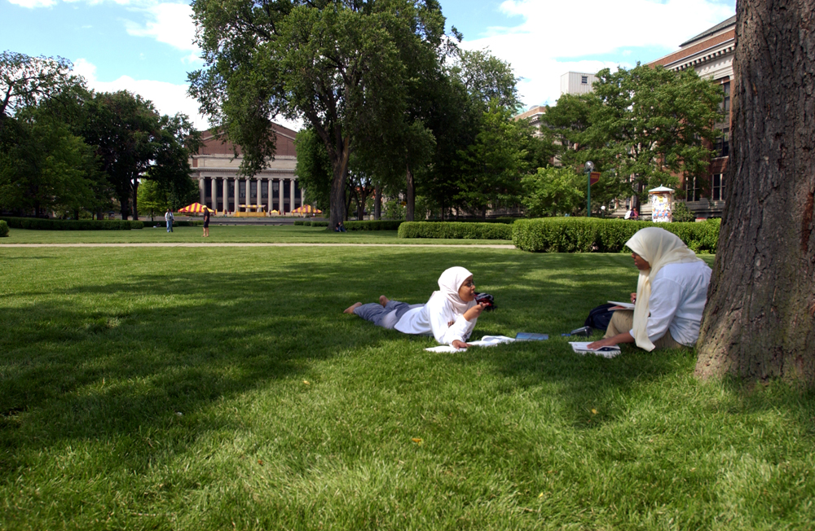

Slide 124
Congratulations graduates! Know that life is a series of glorious accidents, so buckle up and enjoy the ride.
– Karen Woodbury
'88 English

Slide 125
Rachel Christine Patterson
BA Communication Studies
Thanks Mom and Dad for the love and support! Congrats class of '13, we did it!

Slide 126
Jeffrey Pearson BA Journalism High Distinction Mom and dad. Thank you for the never ending love and support you provided me during college. Your third and final child has graduated!!!

Slide 127
Kelli Jean Peterson
BA Journalism

Slide 128
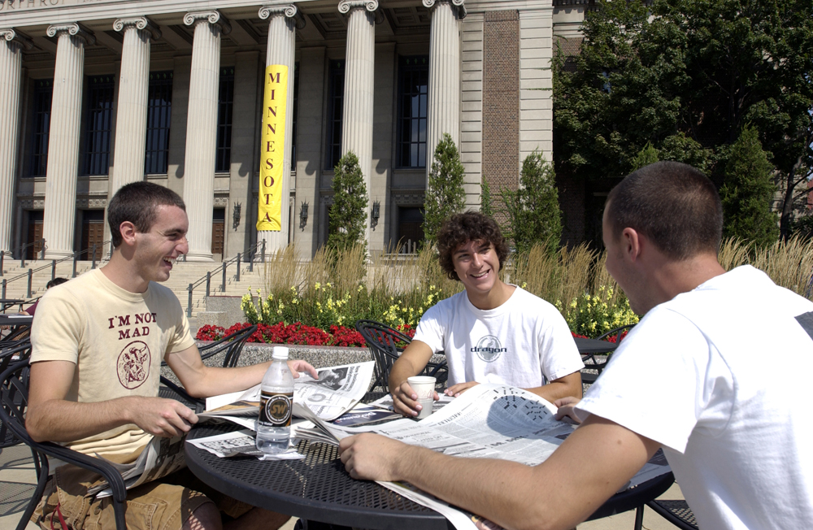

Slide 129
There are many myths, and there is truth. Sift the ore of all myths for the nuggets of truth they contain, and forge from them an honest world view.
– Bob McCune
'72 Humanities, English

Slide 130
Lauren E Pichette
BA Mathematics
Distinction
As Elle Woods once said: "We did it!"

Slide 131
Lydia Anna Richardson BA French Studies Distinction summa cum laude

Slide 132
Kelly Patricia Rinehart
BA Communication Studies

Slide 134
May you always be both relaxed enough and alert enough to note and follow serendipitous opportunities that come your way. Consider writing your life plans down every few years and then looking back to see how closely you followed your dreams.
– Kathleen Brooks
‘76 Psychology

Slide 135
Jody L. Robinson BA Speech-Language-Hearing-Sciences Distinction

Slide 136
Coleman A. Rollins BA Physics Big shout out to the WGA and the Minnesota Evans Scholars! I love you Mom and Dad, I couldn't have done it without you. Shalom!

Slide 137
Kristin Lynn Roth
BA Journalism

Slide 138
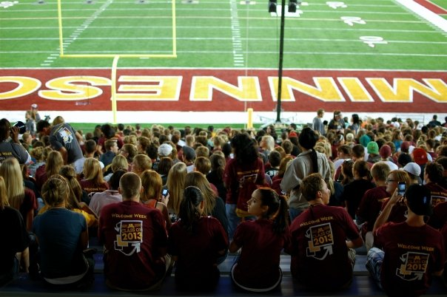

Slide 139
“Be kind, for everyone you meet is fighting a great battle.” – Plato
– Erika Elizabeth Meyer
‘06 Child Psychology

Slide 140
Jennifer Lee Schmitt BA Chemistry

Slide 141
Leola Donnella Sears BA Gender, Women & Sexuality Studies Mom, Quita, Dad, vert, Eric, Mace ,Trae thanks for loving me. My future, Theia, Meme, Lijah, Willow, Melia,& Madie this is your legacy now!

Slide 142
Nicolette Elizabeth Seifert BA Journalism My time as a Golden Gopher is close to my heart as I begin the next adventure. Thanks Mom, Dad, Shane & Trent for supporting me on my way!

Slide 143
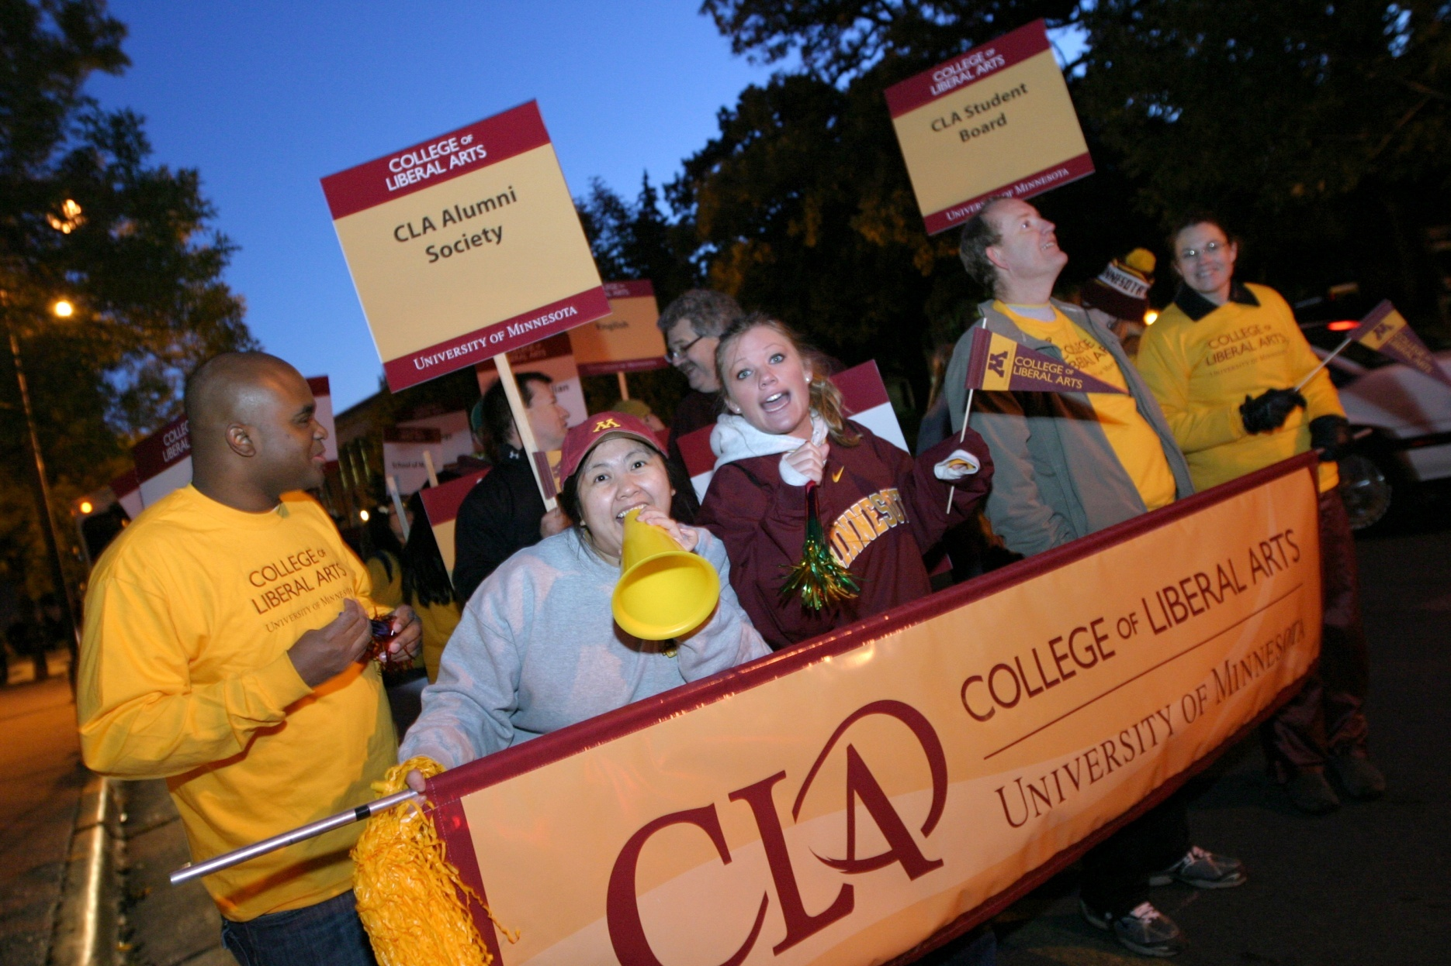

Slide 144
Never stop believing in yourself.
– Fred Olson
'65 Political Science

Slide 145
Alexandra Skaalerud
BA Communication Studies
Thank you!

Slide 146
Leah Smith BA Journalism Thank you, Mom and Dad, Jessica, Kayla, Mariah, and Alex for all the love and support. You guys are the best! World: meet Leah.

Slide 147
Mahyar Sorour BA Biology, Society, & Environment “We do not need magic to transform our world. We carry all of the power we need inside ourselves already.” Congratulations to the class of 2013!

Slide 148
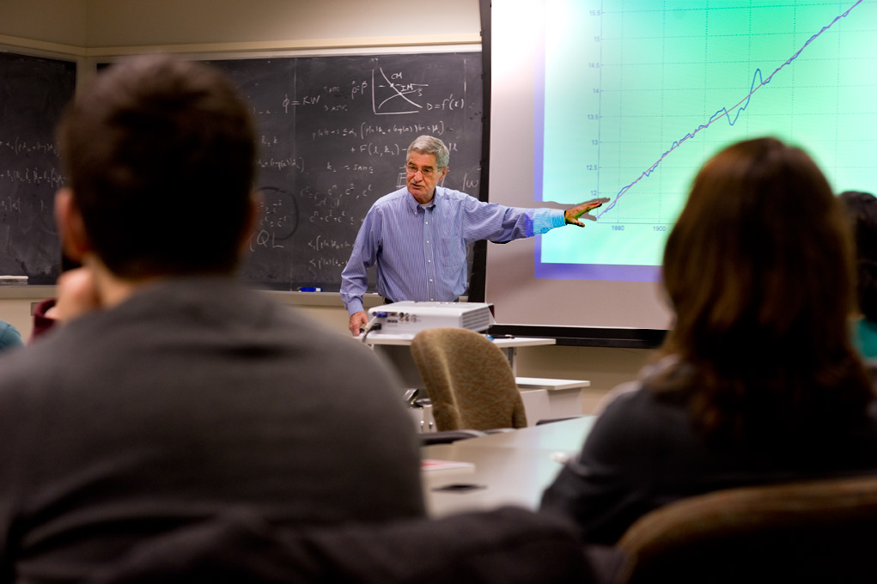

Slide 149
You have received a great education at the U in one of many different disciplines. Whatever your major, keep three thoughts in mind as you move forward. First, move forward! Second, make your world bigger. Third, evaluate with an open mind. Good luck.
– Tom Dupont
Journalism

Slide 150
Xiaoye Su BA Statistics

Slide 151
Kayla Marie Sullivan BA Journalism Can't believe my time and at the U of M has come to an end! It's been an amazing 3.5 years and I'm so proud to be a Gopher for life!

Slide 152
Kyle Lawrence Symanski
BA Mathematics

Slide 154
Make an effort to stay connected to any professors who've truly mentored you or made an impact. It is all too easy to lose touch but even 20 years down the road, you may want to reach back to them and say thanks.
– Beth Schommer
'93 Italian Area Studies

Slide 155
Avalon M Thomas BA Spanish Studies Here's to the future, because we got through the past.

Slide 156
Nikki Vasiliki Triantafilou BA Communication Studies Thank you for everything Mom, Dad, Dimitra and Kevin! You all helped me make it to this day. I could not have done it without you! Love you!

Slide 157
Sabrina Delreese Ulmer-Kuehn
BA Communication Studies
I FINALLY did it!!! It's been a long road Tony Kuehn, thanks for sticking it out with me. I love you. Now let's take a VACATION!!!

Slide 158
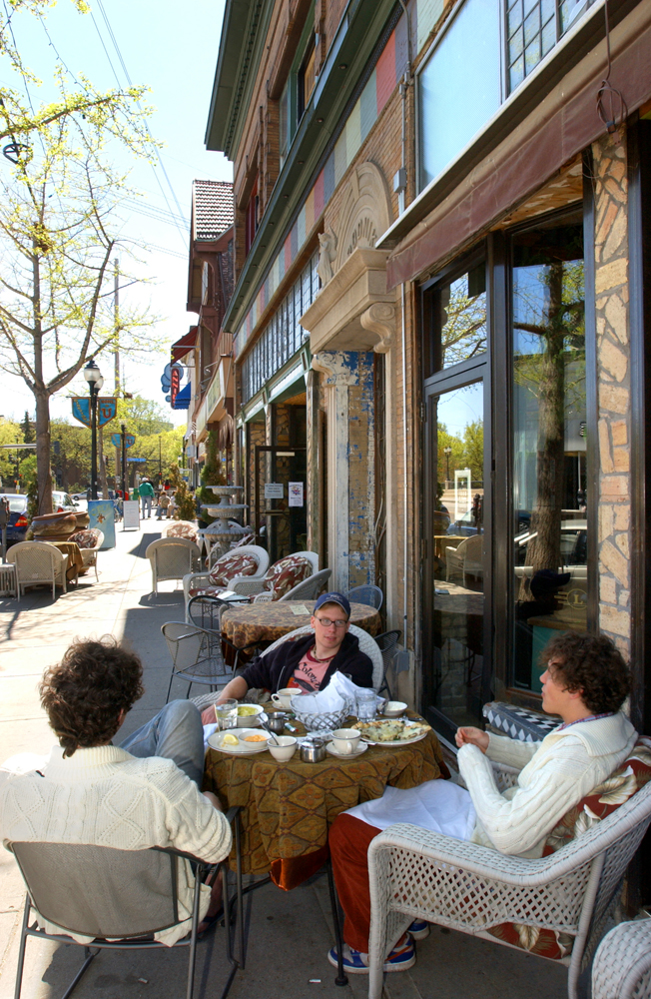

Slide 159
Wherever you travel you will not be far from other University of Minnesota alumni. You have a link to the U of M that cannot be broken, and we look forward to helping you on your journey. Best wishes and good luck as you set sail!
– Bob Snyder
‘68 Political Science

Slide 160
Rebecca M. Underwood BA Journalism BA Communication Studies Distinction

Slide 161
Joseph Verschaetse BA Journalism I am beyond honored to celebrate with the class of '13. Thank you to my mom Lisa, dad Randy, and my fiancé Francine for all of the support!

Slide 162
Nicole Hannah Wait
BA Journalism

Slide 163
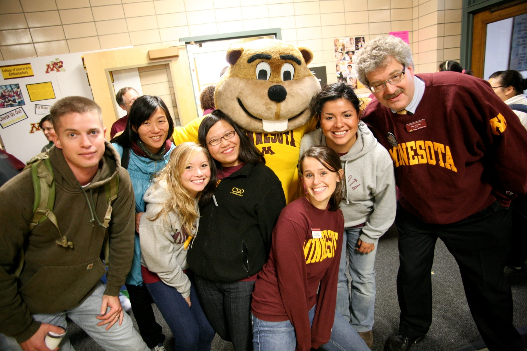

Slide 164
Life is indeed a marathon, not a sprint. When adversity comes your way look it squarely in the face and understand how you deal with it helps define your later success. Remember all the people and circumstances that have contributed to your success, as none of us get to where we are alone.
– Terry Addison
'71 African American & African Studies

Slide 165
Sarah Y. Wang BA Statistics Distinction

Slide 166
Casey Robert Wellman BA Communication Studies Cheers, Seniors! It is time to move forward.

Slide 167
Chelsea Brianna White
BA Journalism
Congratulations to my fellow CLAers! We did it! Time to enter the scary big world, let's go kill it!

Slide 168
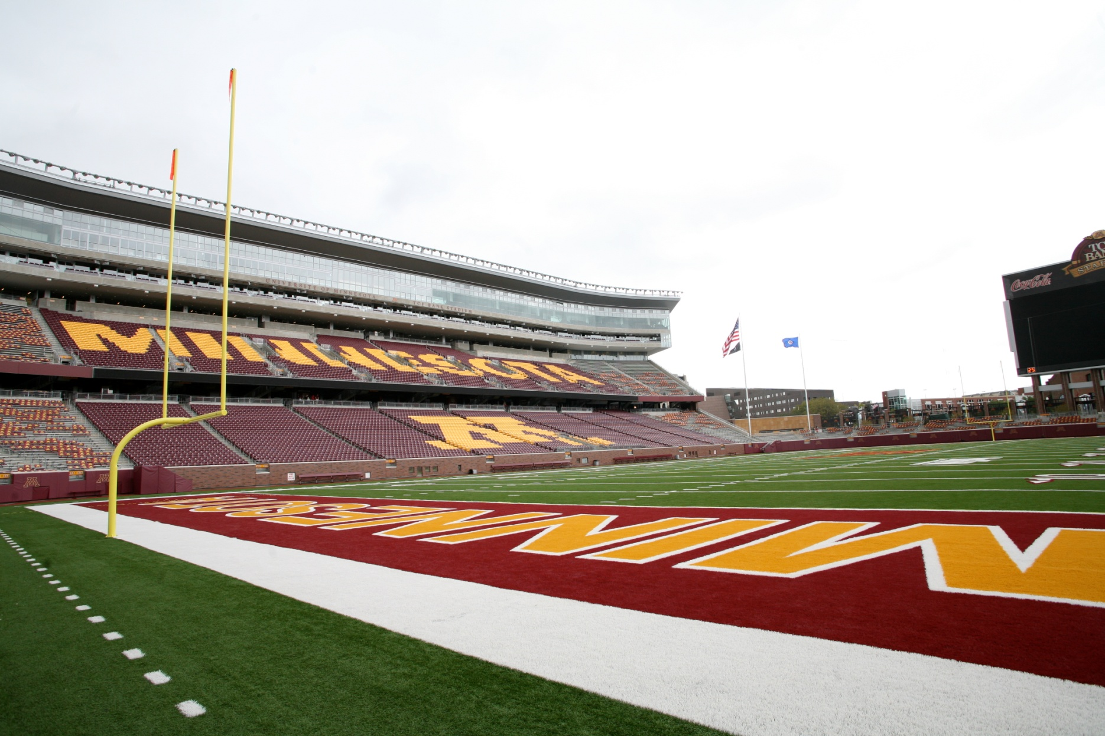

Slide 169
Make an effort to stay connected to any professors who've truly mentored you or made an impact. It is all too easy to lose touch but even 20 years down the road, you may want to reach back to them and say thanks.
– Beth Schommer
'93 Italian Area Studies

Slide 170
Courtney Joy Wolf BA Journalism Thanks Nate for making me go to class. Thanks Lindsey for being my inspiration. Thank you Mom and Dad for everything you do. Love you all.

Slide 171
Yixuan Xie BA Communication Studies

Slide 172
Mengtian Ye BA Statistics 1. Thanks to all my friends. 2. Thanks to all my instructors. 3. I will miss this place. 4. Go gophers Go! 5.Bio-Med is the best.

Slide 174
Don't take yourself too seriously. The ability to laugh at your own foibles can carry you through some otherwise difficult moments.
– John R. Coleman
‘55 Zoology

Slide 175
April Yun BA Biology, Society, & Environment

Slide 176
Leslie Irene Zamzow BA Biology, Society & Environment

Slide 177
Shawna Korin Zielinski
BA Spanish Studies
Community Engagement Scholar
I'm beyond grateful for all the amazing support I've received in these few years. The U of M has become my home & it's a bittersweet ending.

Slide 178
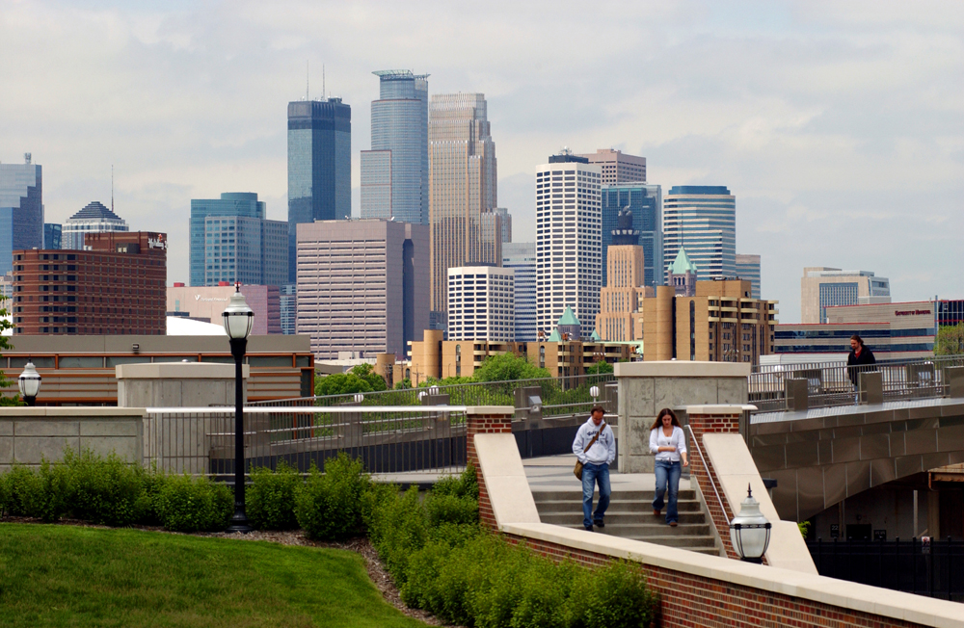

Slide 179
Sometimes the world throws unexpected difficulties in your path while at the same time giving you exciting new possibilities. If you are ready and stay positive, you will see the opportunities and benefit from them. If you become negative you will not see what is in front of you and miss what life has to offer you.
– Harold Beckala
‘70 Chemistry

Slide 180
