Slide 1
Welcome to the Fall 2013 CLA Senior Celebration!

Slide 2
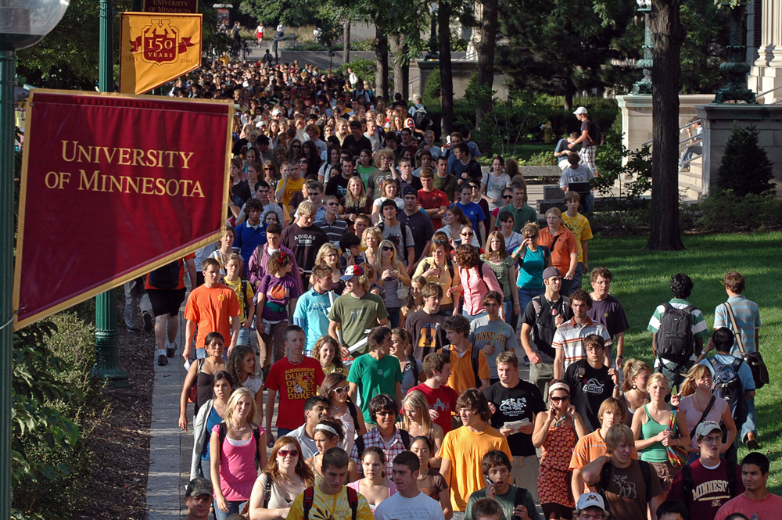

Slide 3
We live on the strength of what we left behind. Wisdom is the art of knowing what to ignore.
– Arthur F. Leuders ’71 Humanities

Slide 4
Alexis Ann Aafedt BA Political Science

Slide 5
Stuart Burton Abel BA Global Studies

Slide 6
Arghavan Abtahi
BS Economics

Slide 7
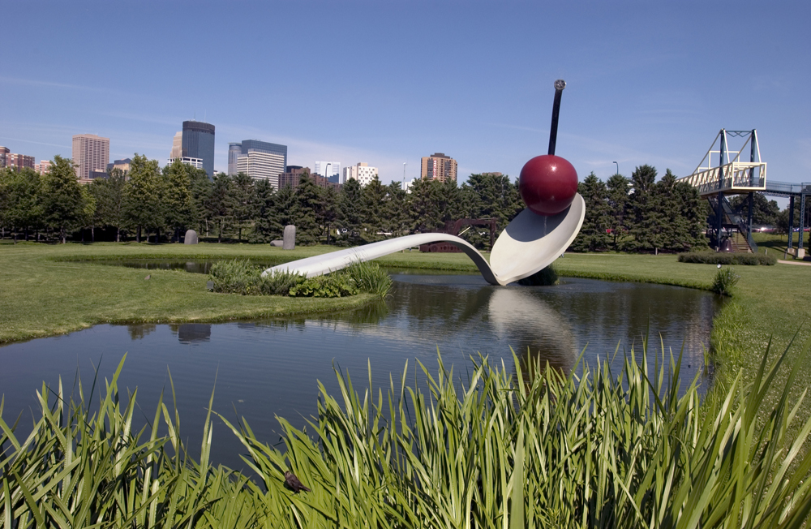

Slide 8
Congrats on making it this far! Take the skills and knowledge you have gained in college to help others and pursue your dreams! Keep positive and stay true to yourself; you can accomplish any aim to which you set your mind!
– Meghan Marx ‘08 Political Science and German Studies

Slide 9
Qutbi Hassan Adam
BA Political Science

Slide 10
Oluwaseun J. Adedeji
BA Sociology of Law, Criminology, and Deviance
All glory to God. Thank you Dad and Mom. Time for us rest of class 2013 to conquer the world. On to greater things tomorrow.

Slide 11
Ryan Patrick Andrews
BA Political Science
Distinction
Special thanks to my Mom, Dad, and all my friends and family for all the support, and for making my time here such a great experience.

Slide 12
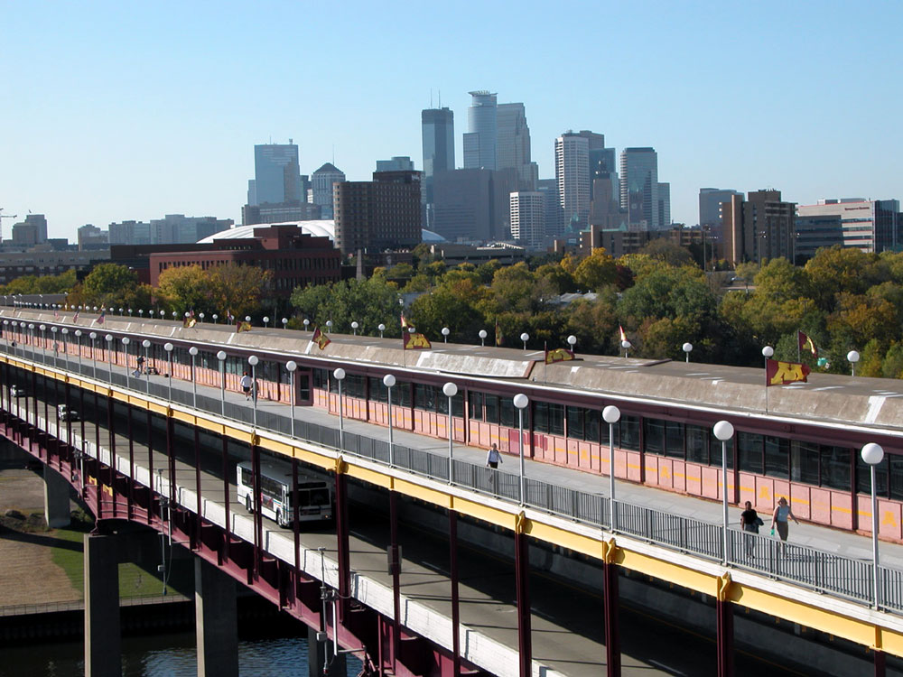

Slide 13
I would consider my college education not so much job training as life training. It is such a wonderful foundation on which to base all future life experiences. It gave me a chance to broaden my thinking and stretch my mind, in order to be receptive to new things throughout the rest of my life.
– Ann Eumurian Snyder ’74 Elective Studies

Slide 14
John Christopher Bertie
BA Sociology of Law, Criminology, and Deviance

Slide 15
Jennifer L. Boldt
BA History
Congratulations to all of the 2013 graduates! Thanks mom and dad for all of your love and support!

Slide 16
Alicia M. Brenhaug
BA Political Science
Ski-U-Mah! Thanks Mom and Dad for footing the bill!

Slide 17
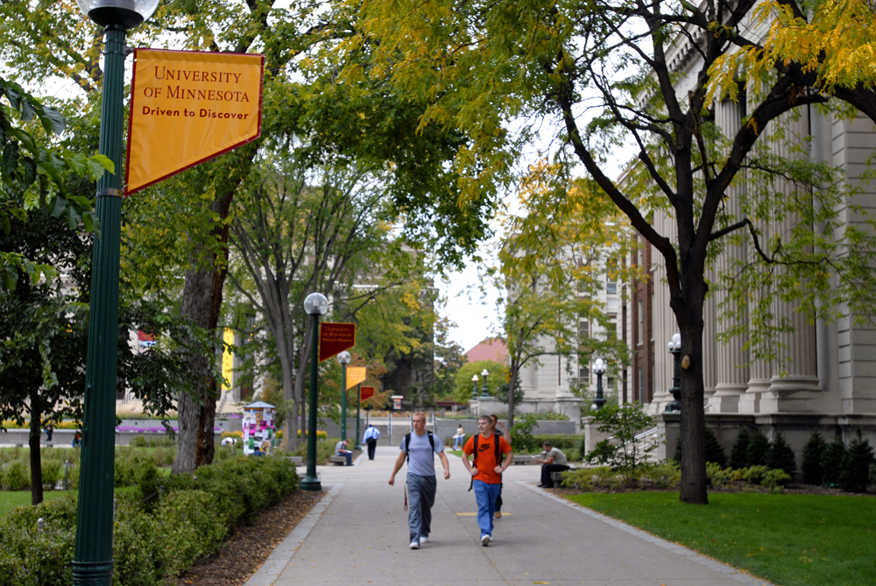

Slide 18
Even if you don't know what you want to do next, just do something. By taking just one step, you'll open more doorways, and new options might arise that you had never even considered!
– Julie Commerford

Slide 19
Foxu Chen BS Economics

Slide 20
Jacob Bryan Christensen BA Sociology

Slide 21
Benjamin Alexander Clark
BA Economics
Distinction
Thanks for all of the support over the years, Mom and Dad! Best of luck to the rest of the graduating class!

Slide 22
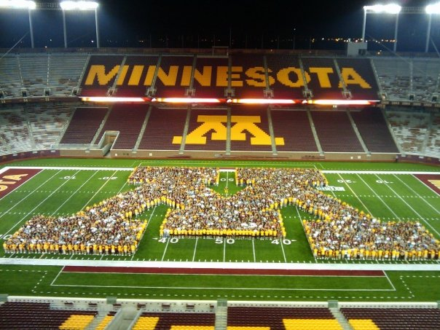

Slide 23
Be sure to find something you love to do...life is too precious not to have joy everyday!
– Ann Konkel Axon '78 Speech Communication

Slide 24
Melissa Collins-Rutter
BA Global Studies
HUGE thanks to my husband Chad for supporting me through school and not letting our daily lives collapse. The long haul is over! Love you!

Slide 25
Justin Cookle BA Anthropology

Slide 26
Xiaomeng Cui BS Economics

Slide 27
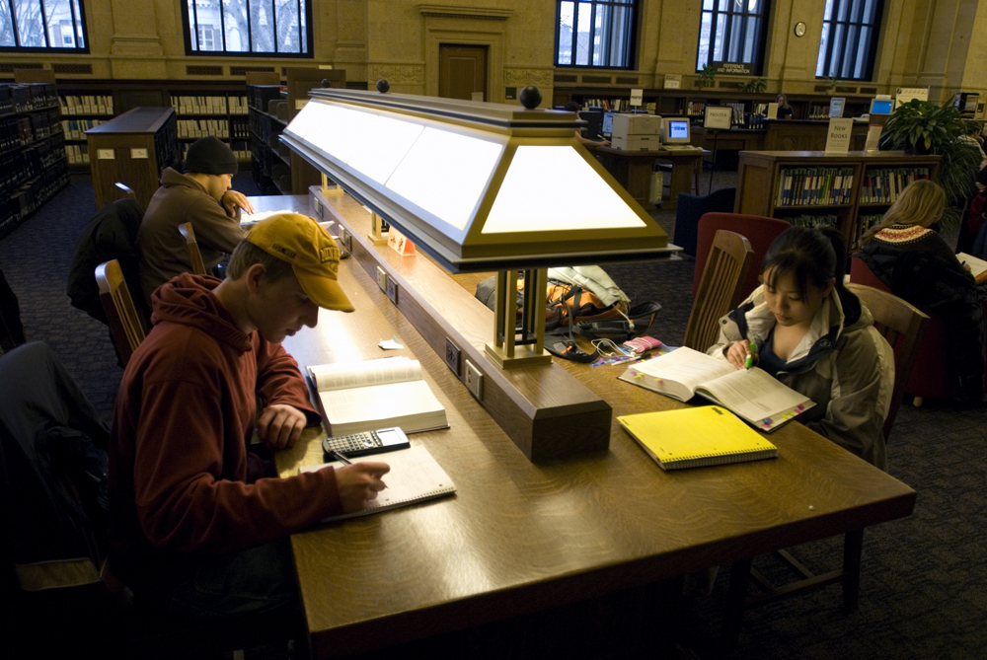

Slide 28
Congratulations on your perseverance and success! The world seems more challenging now than ever, but the truth is, it's always challenging when you first emerge on the scene, degree in hand. Remember, what you choose to do first may not be where you will ultimately "last", but it will shape each subsequent decision you make, so embrace each challenge and work hard.
– Dan Williams ‘84 Speech and Mass Communication

Slide 29
Kathryn Culhane BA Global Studies BA Political Science Class of '13, we did it! Thank you Mom and Dad for your constant support!

Slide 30
Joshua Tague Damberg BA Political Science Congrats to all! Revel in current successes & prepare for future endeavors... Special thanks to those that shared in and supported mine! -JD

Slide 31
Olusogo Joe Daramola
BA Sociology
I can do all things through Christ which strengthen me. Thank you Jesus.

Slide 32
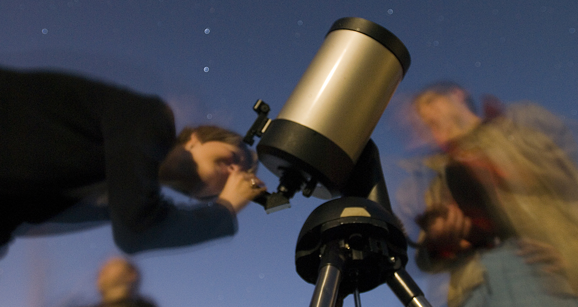

Slide 33
Congratulations seniors! My hope is that you won't be afraid to get your hands dirty and follow your heart, because this is where the adventure really starts!
– Carolina '08 Spanish Studies

Slide 34
Molly P. Davy
BA Sociology of Law, Criminology, and Deviance
Distinction

Slide 35
Claire E. Decaster BS Sociology of Law, Criminology, and Deviance

Slide 36
Anthony Conrad DeMarco BA Anthropology

Slide 37
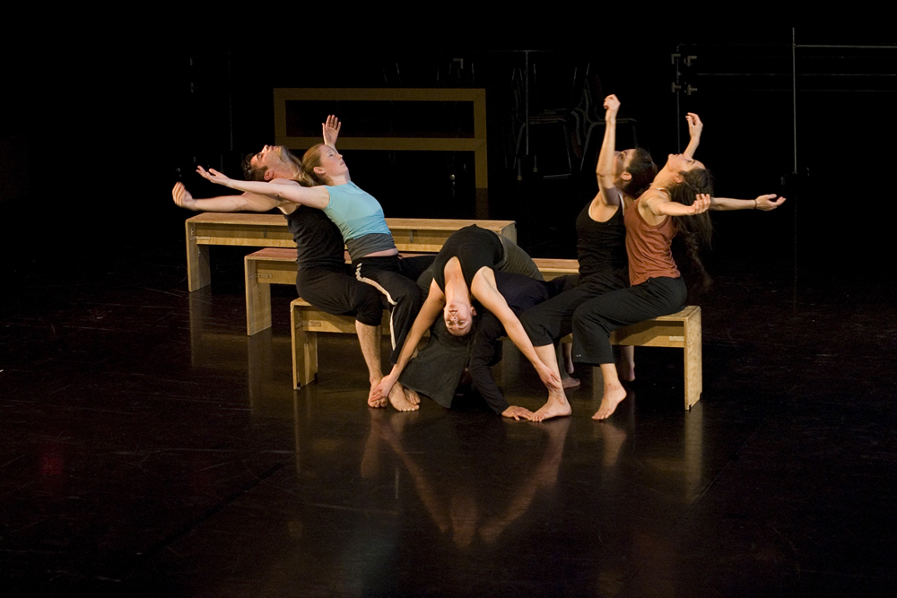

Slide 38
Remember to not put too much pressure on yourself and go with the flow. If your first job is not what you anticipated or not necessarily in tune with your major, be patient. Change can be good, especially over time. Enjoy the fact that you are young and capable of so many things! Think of life as an adventure and know that you are often your harshest critic.
– Jan Bobrowske '72 Spanish

Slide 39
Kelly Elizabeth Ebert BA Economics Congrats Grads - we FINALLY made it! Family & Ron- Thanks for all the support & encouragement! And dealing with me during finals week...

Slide 40
Jargalmaa Erdenemandakh
BA Global Studies
Distinction
summa cum laude

Slide 41
Wei Fang BS Economics I am thankful and blessed to be in this position as a college graduate. Thanks Mom and Dad.

Slide 43
May your desire to learn be a cup that never empties.
– Kathryn Black Kohn ’03 Psychology

Slide 44
Disha Feng BA Economics

Slide 45
Zachary Breen Forschler BS Urban Studies Would not be here if it was not for Mom, Dad, Siblings, Family, Friends, and Grandparents. Thank you for the support and sticking with me.

Slide 46
Manar M. Gad
BA Sociology

Slide 47
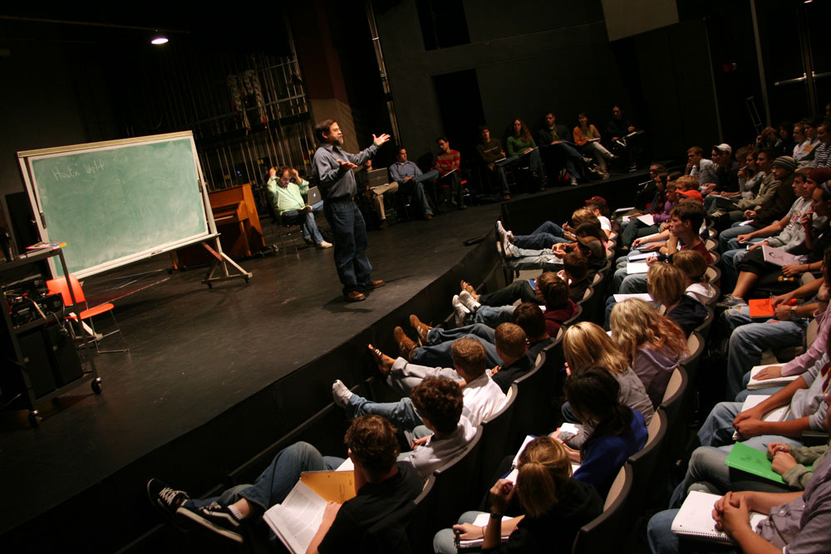

Slide 48
Be ready to try challenges that appear in your life. Whether you succeed in them or not, you'll gain attitude and confidence to proceed along many paths in life.
– Dick (Tiger) Sherman '58 Journalism

Slide 49
Ge Gao
BA Philosophy

Slide 50
Xiaowen Gao BS Economics Distinction Congratulations to the class of 2013! I love my Dad and Mom forever!

Slide 51
Anna L. Gedstad BA Political Science Hello!!!!!!!

Slide 52
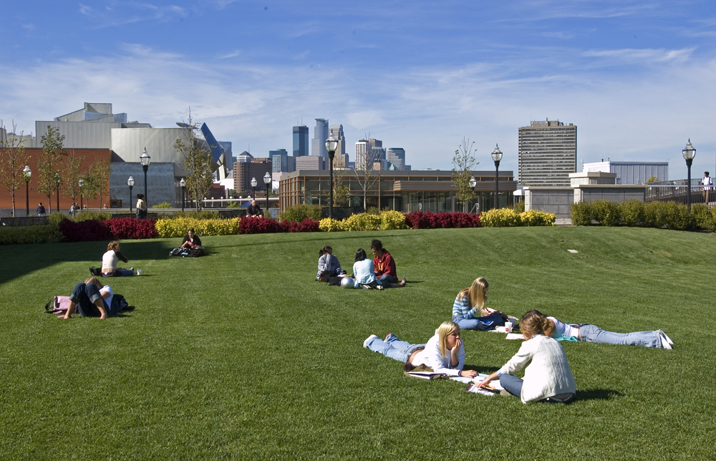

Slide 53
The U of M and Gophers in general are connected across the world. Stay connected. You will need help along the way and others will need your help. Know that a fellow Gopher is willing to give you a chance, help you or give advice. You will have your turn to "pay it forward" to a fellow Gopher, and see the joy, in kindness at work. Stand proud aside decades of proud Gophers!
– Martha Hoover ’84 Business, Economics

Slide 54
Zachary Benson Graham
BA Sociology
I love you all.

Slide 55
Robert J. Green BA Geography It's been a long journey, but I've finally did it. Thanks to everybody that has supported me.

Slide 56
Xiaoyu Guo BA Economics

Slide 57
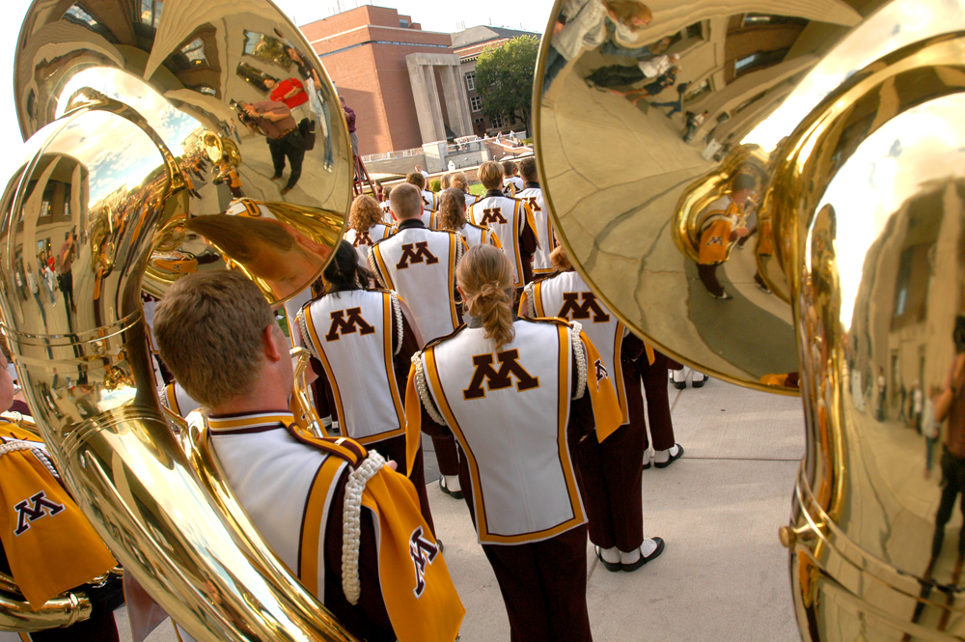

Slide 58
Set your goals high, stay focused, consider positive advice, work hard, and most importantly believe in yourself and what you want to do, and do it!
– Roma Calatayud-Stocks B.A. ‘87

Slide 59
Joseph W Hafften BA Sociology of Law, Criminology, and Deviance

Slide 60
Justin Michael Hagen
BS Economics

Slide 61
Elizabeth Hansen BA Sociology

Slide 62
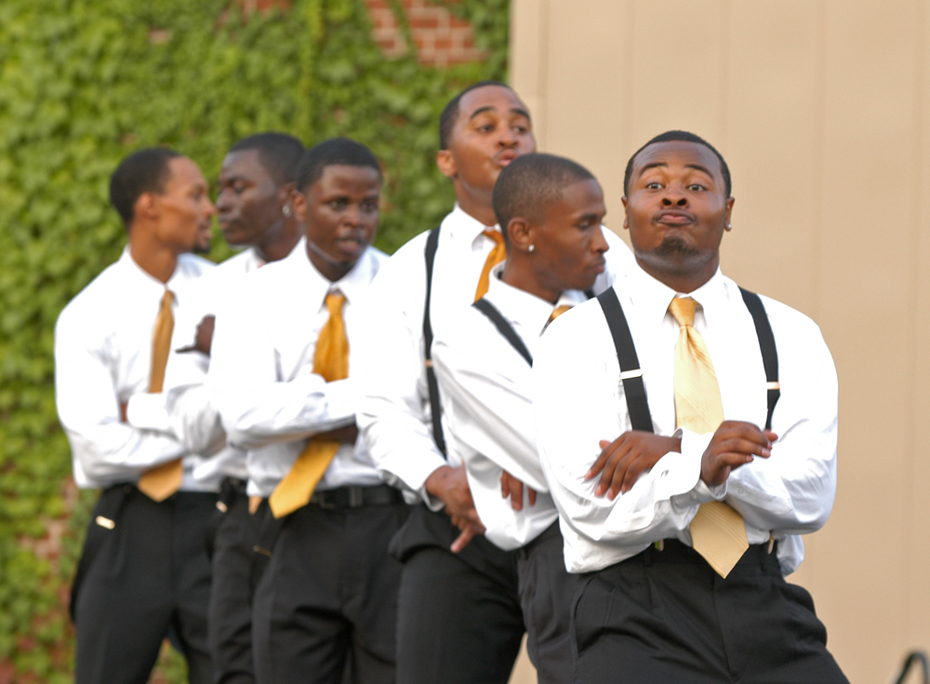

Slide 63
An anonymous quote – have no idea of the source –but I live by it and always teach it to others: Teach thy tongue to say "I do not know", and thou shalt progress.
– Mary Maguire Lerman ‘74 Spanish and Portuguese

Slide 64
Nicola Marie Harger BA Journalism

Slide 65
Christine Noel Hart
BA Political Science
BA Communication Studies
We did it!

Slide 66
Cameron J Haskell BA Sociology of Law, Criminology, and Deviance CONGRATS CLASS OF 2013! GO GOPHERS!

Slide 67
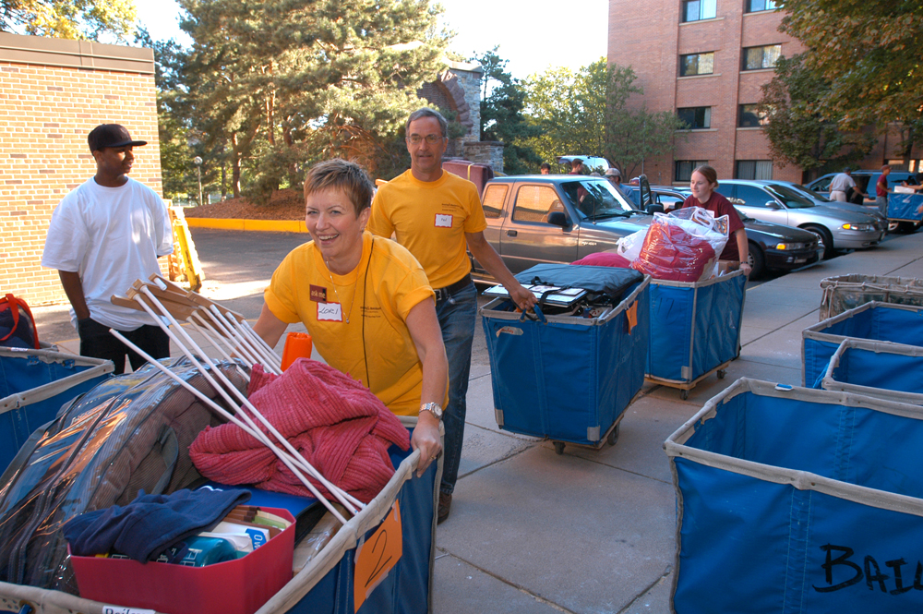

Slide 68
Follow through with whatever you set out to do. A college degree is merely a launching pad...think outside of the box and do good to others treating them as you would like to be treated.
– Sandra Myklebust ‘74 Social Welfare

Slide 69
Maxwell Herberg BS Economics

Slide 70
Deitra Louise Hinck
BA Economics

Slide 71
Tabitha R Hobart BA Sociology of Law, Criminology, and Deviance

Slide 72
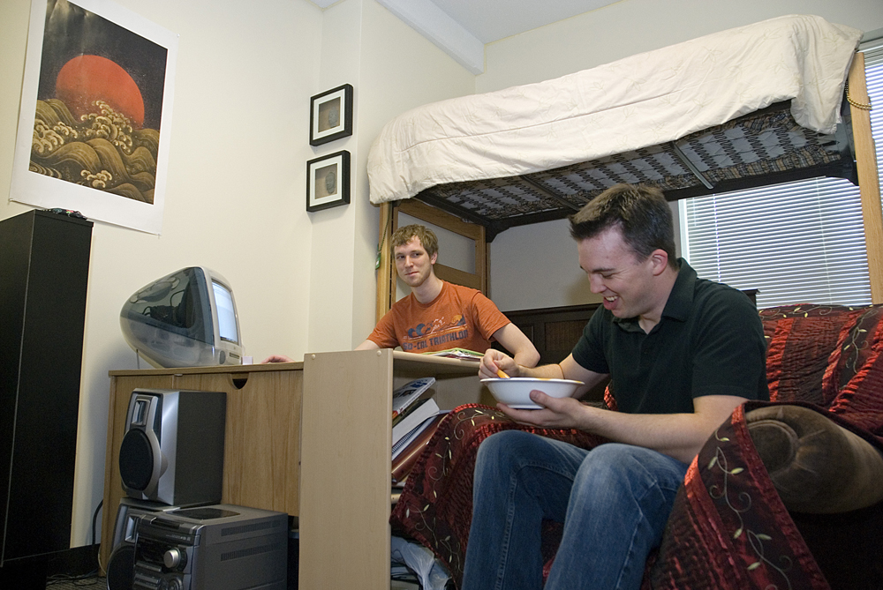

Slide 73
Be willing every day to stretch yourself, to try new things, even if you have already convinced yourself you cannot do something, because every failure is really a success, if you learn from it.
– Al Benson ‘70 Economics, Journalism

Slide 74
Marja Holm BA Global Studies Thank you for making this happen Mom and Dad, I love you so much!

Slide 75
Kelsy Lynn Hutchins BA Political Science BA Sociology of Law, Criminology, and Deviance Congratulations my fellow graduates and welcome to the real world!

Slide 76
Carmen Marie De Couto Jonas BA Global Studies
Congratulations on all your hard work, and a huge thank you to my awesome husband for his love and support!

Slide 77
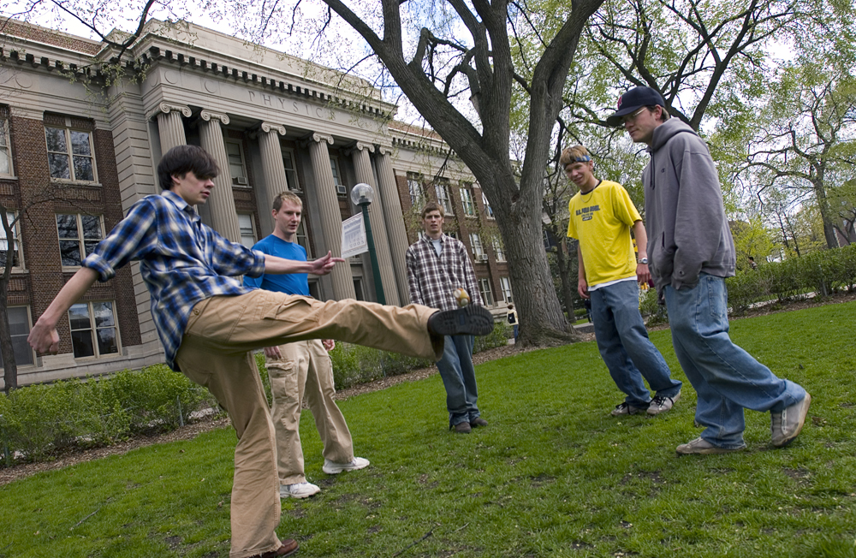

Slide 78
My father has shared this with me at times when I was facing a tough situation – "Every project looks like a failure from the middle.”
– Tom Klas International Relations

Slide 79
Alimamy Fakulie Kamara
BA Economics

Slide 80
Jeong Gyun Kang BA Political Science Thank for supporting me: Elizabeth Beaumont, Rose Miskowiec, and Christopher Xaphakdy! Lastly, I love you mom, Heidi and Sophie Ham.

Slide 81
Patrick Steven Kenny BA History

Slide 82
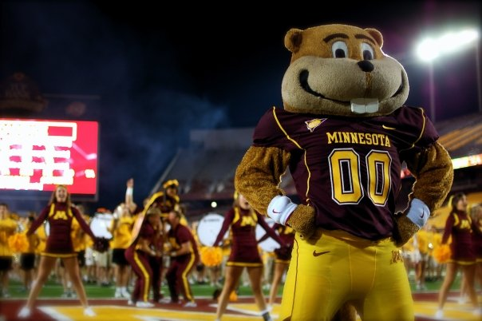

Slide 83
Remember the U of M as you make your way through life’s journey and think of those on campus who made your years at the U meaningful and worthwhile ones. When the pleas for funds come, open your hearts, minds and wallets. Here's to the adventures that await you.
– Larry Gold ’64 Political Science

Slide 84
Anna Elizabeth Kerben BA Global Studies

Slide 85
Lauren Yon-Soo Kim BA Global Studies High Distinction summa cum laude Thanks Dad and Mom for all the support not only financial but also emotional one! Thanks friends for being there. I Love you so much!

Slide 86
Katie Laura Knoblauch
BS Urban Studies
It is never too late!

Slide 87
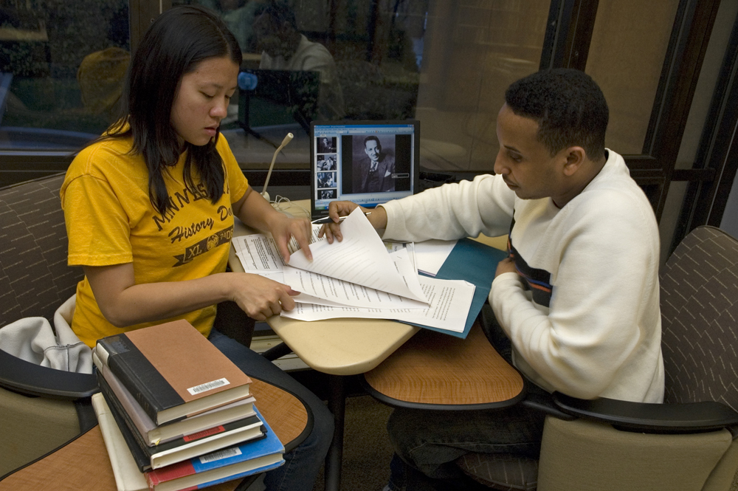

Slide 88
I have more and more come to the conclusion that to take advantage of an education, we need to become well rounded and critical and informed thinkers in many areas. In a democracy people need to know about a great deal relating to our culture and those of the whole world historically. Don't just be a robot, be a whole human being.
– Mark Walsh ‘90 Philosophy

Slide 89
Youngjin Ko
BA Economics
Finally, we are done! New challenges are waiting for us! Go Gophers!

Slide 90
Emily Lauren Kramer BIS Global Studies, Public Health and Sustainability Studies "And the day came when the risk to remain tight in a bud was more painful than the risk it took to blossom.” -Anais Nin

Slide 91
Abigail Krzmarzick BA Spanish Studies Distinction Sometimes, there are bigger plans out there waiting for you than you could have ever imagined for yourself. ¡Así es la vida, hay que viver!

Slide 93
Be appreciative of the opportunities afforded to you at this wonderful institution. Its history...past and present...are special.
You are a part of the family of CLA. Be proud of that heritage.
– Kathryn Anderson '66 Sociology

Slide 94
Yia Kue
BA Sociology of Law, Criminology, and Deviance

Slide 95
Eun Joo Kwak
BA Global Studies
BA Sociology of Law, Criminology, and Deviance
Distinction

Slide 96
Chong Lan BS Economics

Slide 97
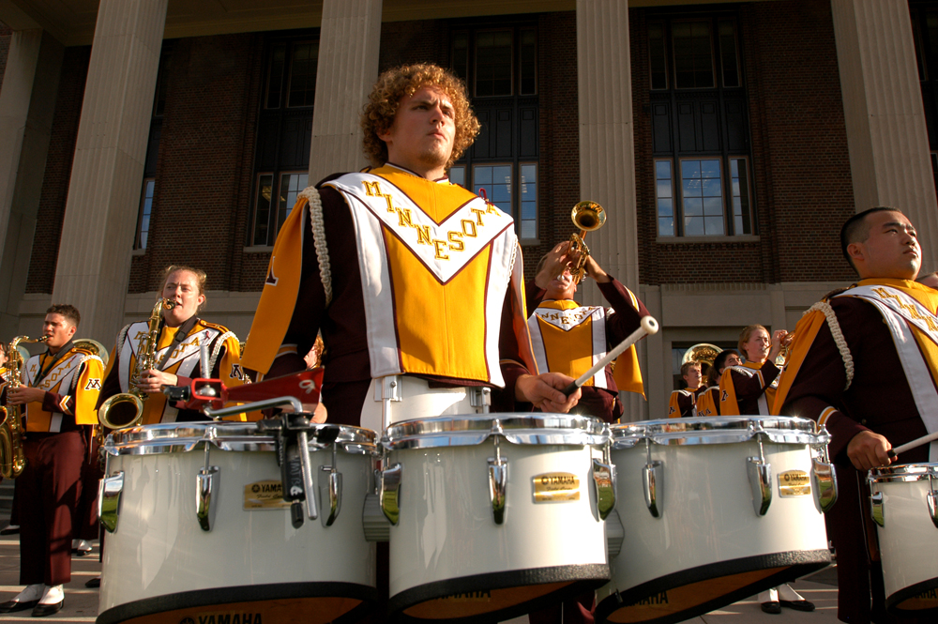

Slide 98
Cherish the unexpected – seek it out! You will then find the value of a liberal arts education.
– Mike Dardis
History, Geography, Business

Slide 99
Robert Isaac Thomas Lancaster
BA Political Science

Slide 100
Aleah V. Laughlin
BA Global Studies

Slide 101
Nicholas James Leach BA Urban Studies

Slide 102
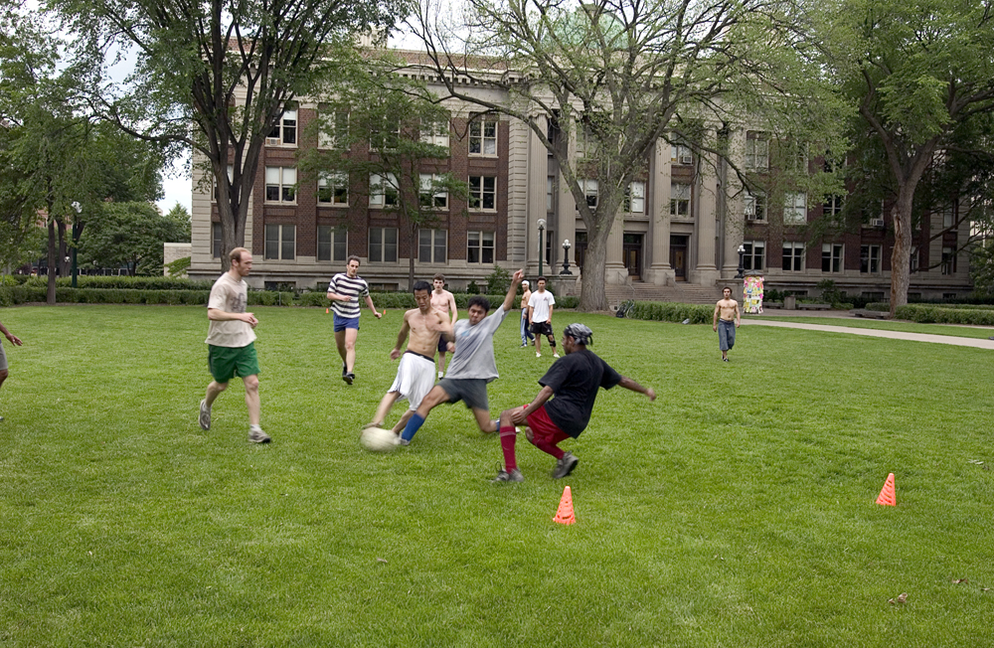

Slide 103
Remember...it is not only about what you've learned while in college but also who you've become – as a friend, a citizen of the world, and, most of all, as a person. Be the best you can be, follow your passion, and be kind to yourself and others.
– Mary Melbo
'72 Psychology

Slide 104
Ting Wai Lee
BA Sociology

Slide 105
Katie Elizabeth Lembke BA Anthropology

Slide 106
Nathaniel Patrick Leonard
BA Political Science
Shout out to Julie and Patrick. We did it, you guys. You're officially good parents.

Slide 107
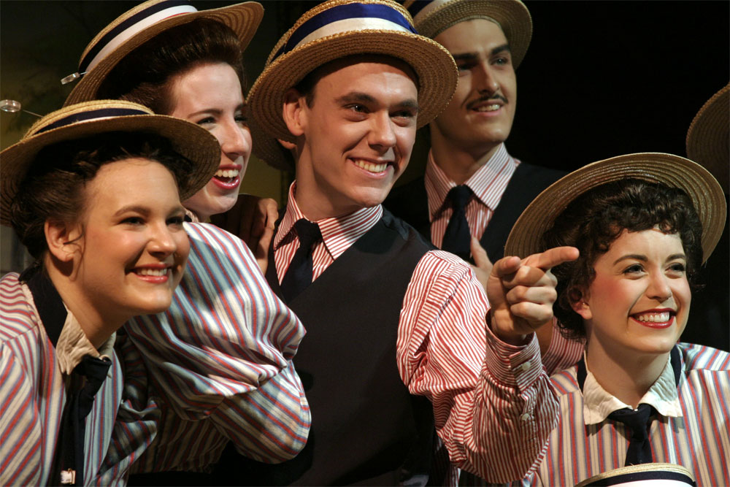

Slide 108
At the end of every day, even if it's been difficult, stop and think of ten things you are grateful for. They can be as small as someone smiling at you or as big as landing a new job. Having gratitude makes life much happier.
– Consuello Smith
B.A. ‘59

Slide 109
Ana Maria Liard-Blanco BS Economics BA Mathematics magna cum laude Here's to the adventures ahead thanks to the academic journey & even the struggles. Thank you Mum & Dad for your continual support & love.

Slide 110
Daniel Ford Lightfoot BA Political Science Distinction

Slide 111
James Edward Longtin
BS Sociology of Law, Criminology, and Deviance
Awesome! We are graduating! Soon we will be looking back with fondness on memories of our beautiful university's tenacious teachers.

Slide 112
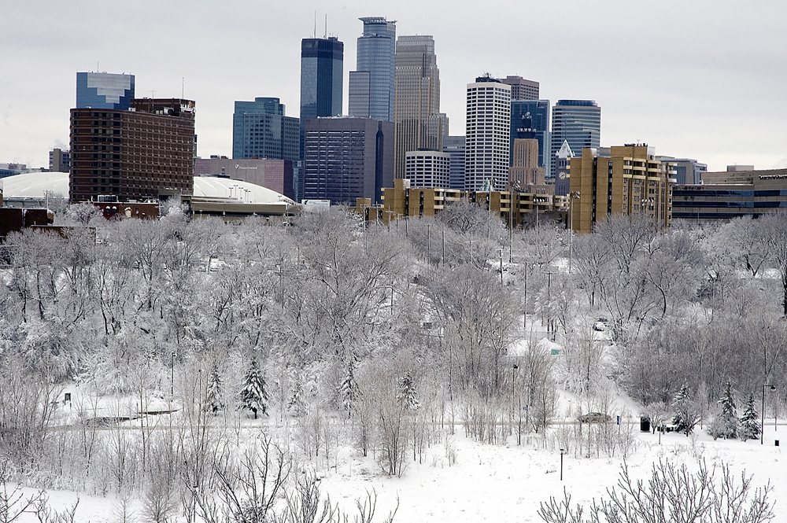

Slide 113
You've done something remarkable - you've graduated with a degree from the College of Liberal Arts at the University of Minnesota. No matter what other amazing things you do in your life, and there will be others, this spectacular, incredible achievement should fill you with pride. Congratulations!
– Nanette Hanks
‘88 Humanities, Art History

Slide 114
Nicole Lovegren BA Global Studies BA Political Science

Slide 115
Ashley Marie Lutz BA Anthropology

Slide 116
Cole T. Lyon BA Sociology of Law, Criminology, and Deviance "Whatever the mind of man can conceive and believe, it can achieve." -Napoleon Hill

Slide 117
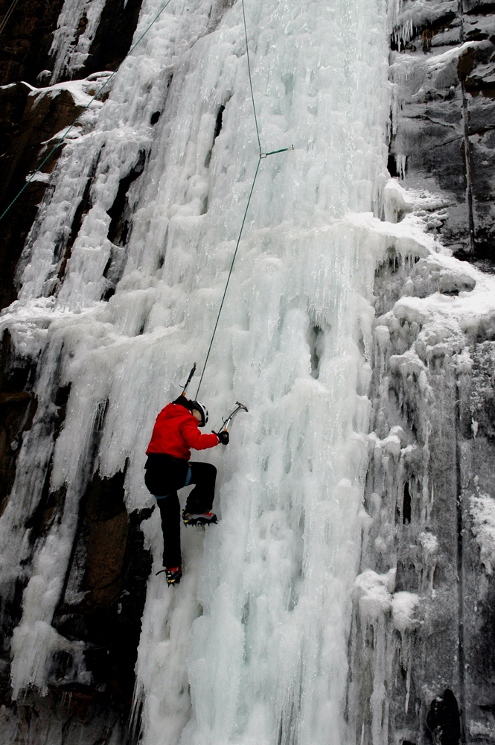

Slide 118
Do your best. Love what you do. Love yourself. Look and listen. Be strong. Be forgiving. Respect yourself. Respect others. Create. Stand up for others. Take care of children. Stay curious. Learn new things. Read. Slow down sometimes. Protect nature. Grow things. Keep an open mind. Be honest. Set goals. Believe in a higher power. Have fun. Teach what you know. Be generous. Learn from the past and be excited for the future. Never cheat. Help with the work. Remember birthdays. Take responsibility for your actions. Laugh a lot.
– Karen Davidson
‘97 Art History

Slide 119
Marissa Miriam Madson BA Sociology of Law, Criminology, and Deviance I am so grateful for my time at the U. Thank you friends and family for helping to make this such a wonderful experience :) So excited!!

Slide 120
Camille Beverly Suzanne Marrinan
BA History

Slide 121
Erin N. Martin BA Sociology The best is yet to come.

Slide 122
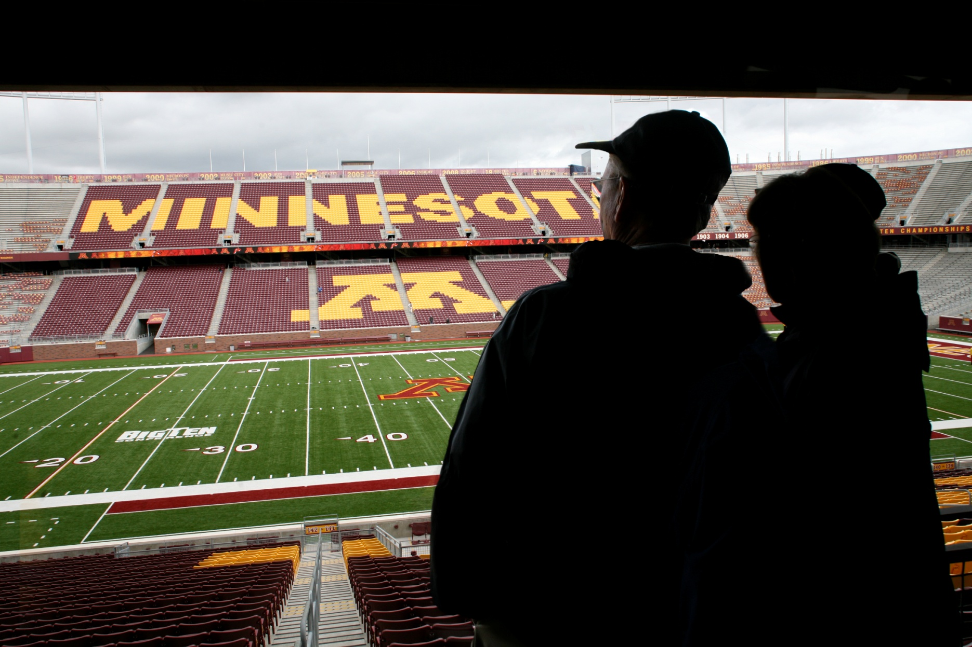

Slide 123
Don't be afraid of the future or yearn for the past. Be ready to go a direction or place (including continent) you weren't planning. It's usually the opportunities you weren't prepared for that turns out to be the most fun and rewarding.
– Ashley Halbach
'10 Journalism, Theater

Slide 124
Mitchell Lewis Menigo
BA Political Science
Thank you parents. On to the next chapter of my life. Come at me, world!

Slide 125
TJay N. Middlebrook BA Global Studies Thanks to my amazing Fiancee Genna you're nothing but support! Love you Mom and Dave thank you for being there when I needed you guys!

Slide 126
Macae Emma Mobraten BA Sociology of Law, Criminology, and Deviance

Slide 128
Here's to you, graduates true. Your road, no doubt, was long...you, however, remained strong! And now a bright new world is opened to you!
– Corey Kellett
'99 Public Relations

Slide 129
Shelby L. Morton
BA Political Science
FINALLY. We made it. Congrats Fall '13! Thank you to my family, friends, faculty, and staff who believed in me - you helped get me here.

Slide 130
Damir Mussin BA Economics

Slide 131
Evan Walter Nelson BA Political Science Distinction

Slide 132
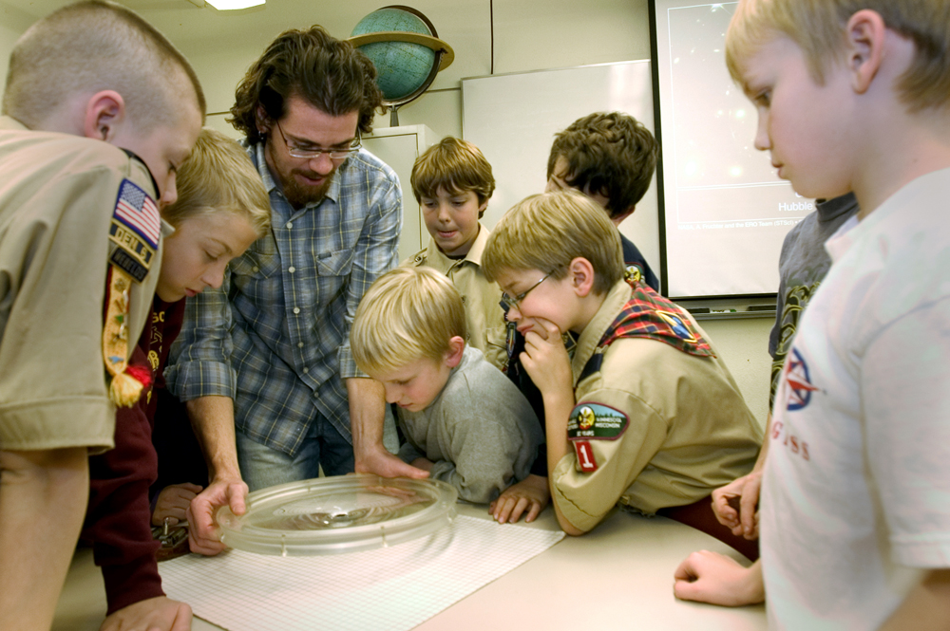

Slide 133
Remember its your attitude not your aptitude that determines your altitude in life.
– Mario Casa de Calvo
‘74 Communications

Slide 134
Timothy Robert Nesheim
BS Economics

Slide 135
Bria Melin Nollenberger BA Political Science summa cum laude

Slide 136
Kelsey Reimer O'Connell BA Global Studies

Slide 137
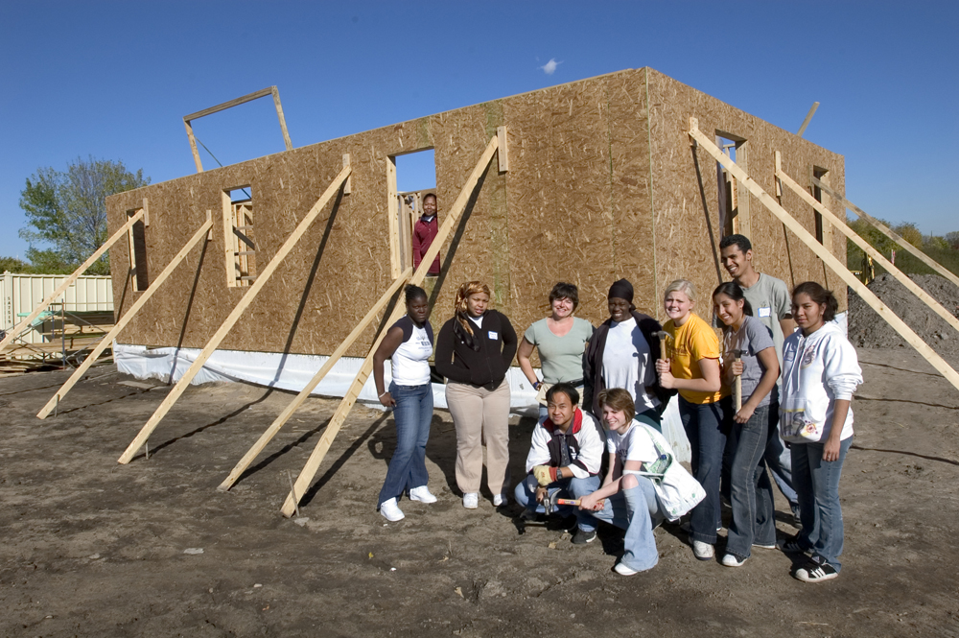

Slide 138
Congratulations! You did it! Never forget this moment or the opportunity you had to receive such an incredible education. Get out there and do something great! Continue to make the University of Minnesota proud!
– Abby Geraets
'09 Architecture

Slide 139
Aoife Margaret O'Connor BA Global Studies BIS Bachelor of Individualized Study Community Engagement Scholar

Slide 140
Robert James Olsen BA History BA Religious Studies Graduation already! I can hardly believe it. I'm thankful to the Lord for bringing me through it - and excited to see where He brings me next.

Slide 141
Stephen M. Owen BA History High Distinction

Slide 142
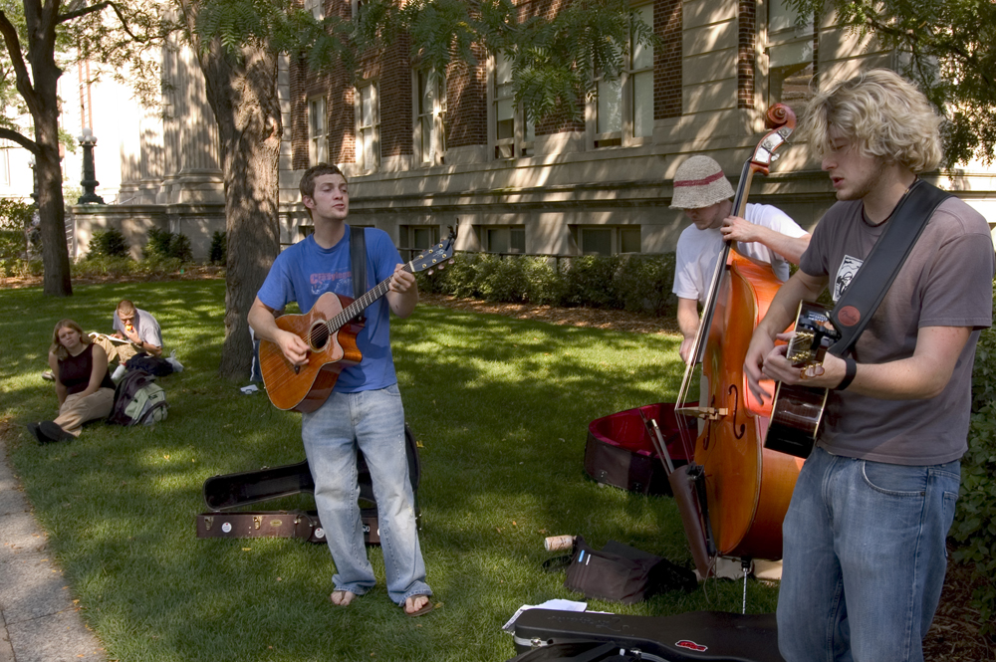

Slide 143
Keep your chin up and your nose to the grindstone. If you can figure out how to accomplish these two things at once, you'll at least find a job as a contortionist.
– Clark Hauschildt
'98 Geography

Slide 144
Josephine Hope Peterson
BA Political Science

Slide 145
Alejandra P. Quintero BA Anthropology Thanks to all my loved ones for your support and encouragement throughout my life and for helping me get to this point. I love you all very much.

Slide 146
Alyssa Lynn Rhodes BIS Art, Communication Studies, and Design Studies peace out, haterz

Slide 147
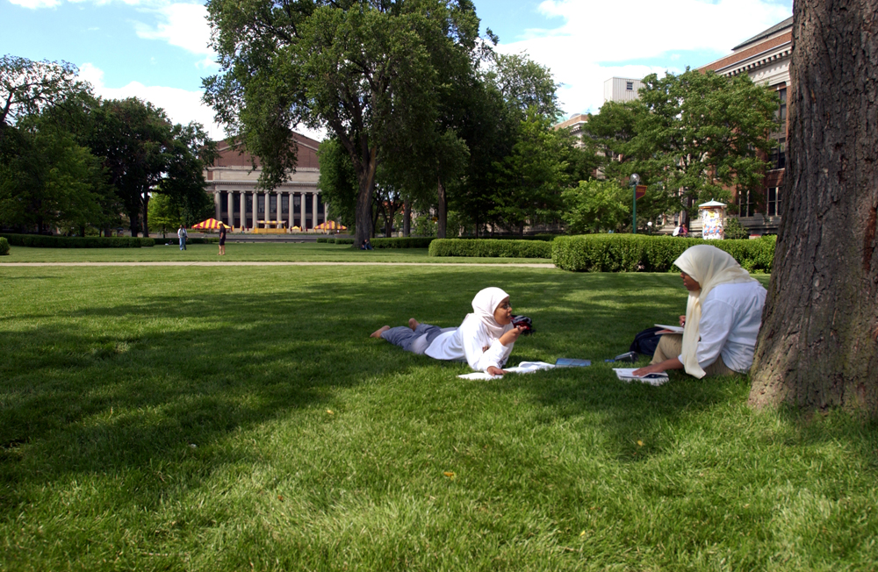

Slide 148
Congratulations graduates! Know that life is a series of glorious accidents, so buckle up and enjoy the ride.
– Karen Woodbury
'88 English

Slide 149
Kelly C. Roberts
BA Sociology of Law, Criminology, and Deviance
Thanks Mom, Marly and Ryan for all the support.

Slide 150
Alanna Z. Rodriguez-Hines BA Global Studies Thank you to all who had a positive impact on my stay at the University! I have learned so much.

Slide 151
Kristine Elisabeth Rohlf
BA Political Science

Slide 152
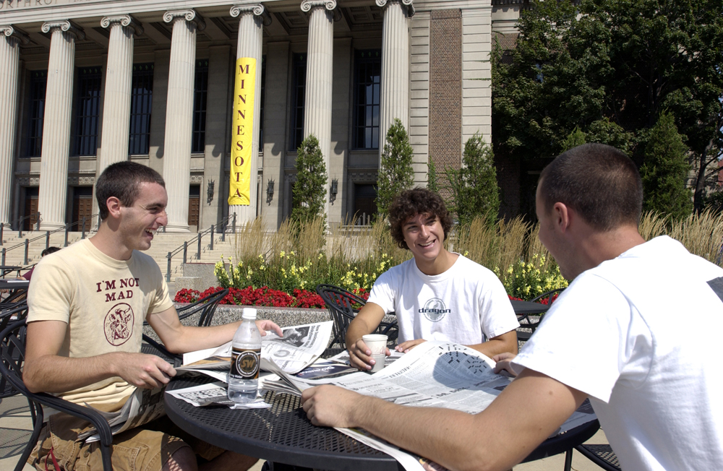

Slide 153
There are many myths, and there is truth. Sift the ore of all myths for the nuggets of truth they contain, and forge from them an honest world view.
– Bob McCune
'72 Humanities, English

Slide 154
Joseph Dolan Rossi
BA Sociology

Slide 155
Kayla Elizabeth Schlumpberger BA Sociology of Law, Criminology, and Deviance

Slide 156
Lauren Kathleen Schrader
BA Political Science

Slide 158
May you always be both relaxed enough and alert enough to note and follow serendipitous opportunities that come your way. Consider writing your life plans down every few years and then looking back to see how closely you followed your dreams.
– Kathleen Brooks
‘76 Psychology

Slide 159
David Randall Schuldt BS Economics

Slide 160
Tonja Rose Shudy BA Sociology of Law, Criminology, and Deviance Congrats to the class of 2013!! A big thanks to my family and friends for all the support these last few years! <3

Slide 161
Scott Smith
BA History
Thank you so much to my friends and family who have supported me along the way! Congrats to everyone graduating!

Slide 162
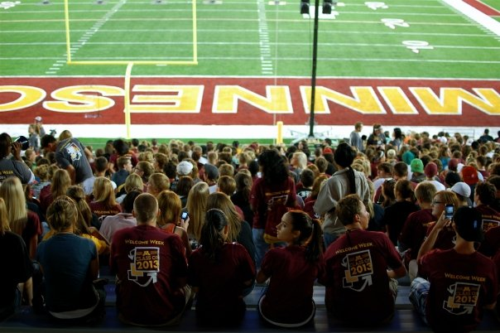

Slide 163
“Be kind, for everyone you meet is fighting a great battle.” – Plato
– Erika Elizabeth Meyer
‘06 Child Psychology

Slide 164
Camille Rose Solon BA Sociology of Law, Criminology, and Deviance

Slide 165
Tyler Matthew Stanley BA Philosophy BA English Community Engagement Scholar

Slide 166
Travis Matthew Stearns
BA Sociology

Slide 167
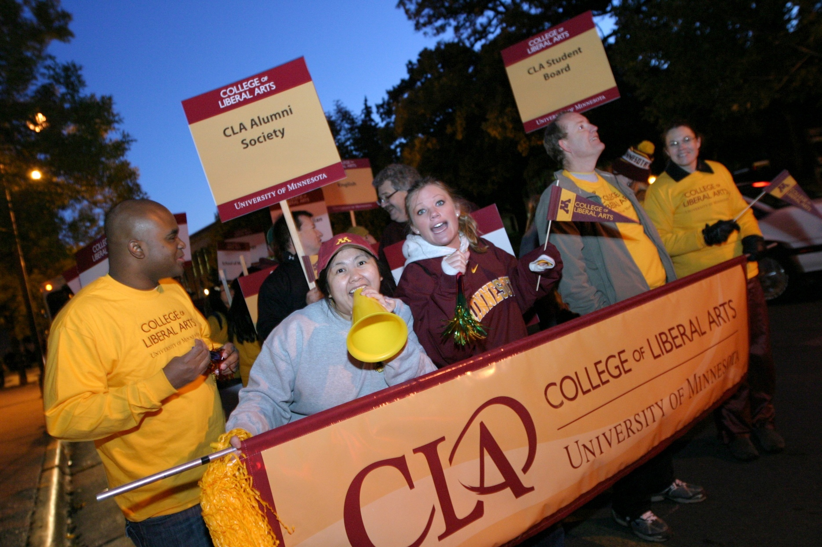

Slide 168
Never stop believing in yourself.
– Fred Olson
'65 Political Science

Slide 169
Bethany Lynn Stepanek BA Anthropology

Slide 170
Lindsay Michelle Stockwell
BA Sociology of Law, Criminology, and Deviance
Thanks for all the support everyone! I couldn't have done it without you!

Slide 171
Rudi A Summers BA Sociology of Law, Criminology, and Deviance

Slide 172
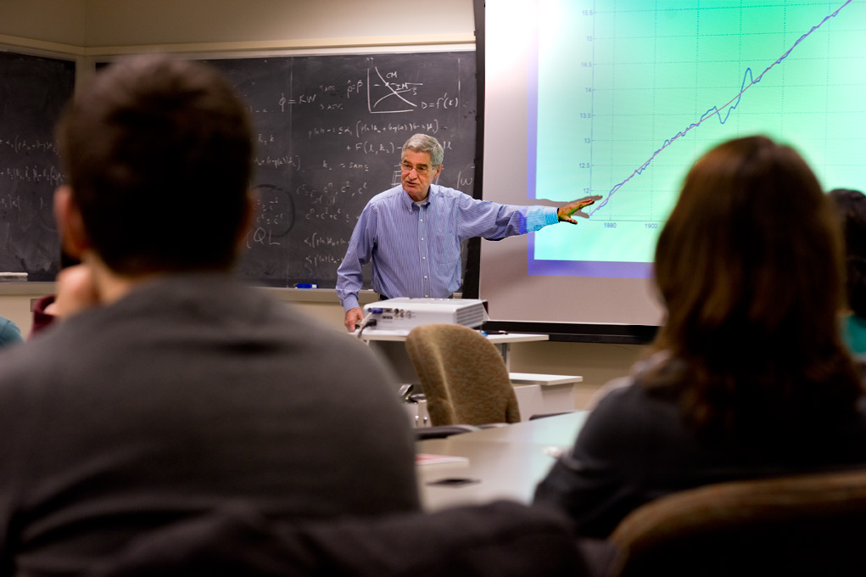

Slide 173
You have received a great education at the U in one of many different disciplines. Whatever your major, keep three thoughts in mind as you move forward. First, move forward! Second, make your world bigger. Third, evaluate with an open mind. Good luck.
– Tom Dupont
Journalism

Slide 174
Xinwei Sun BS Economics

Slide 175
Jeffrey Parker Sylte BS Economics Congratulations to the class of 2013! Thanks to everyone who supported me along the way. All that hard work is finally paying off!

Slide 176
Kurtis Lee Syvertsen BA Sociology of Law, Criminology, and Deviance Thanks Mom, Dad and Kristen for all the support you provided me over the past three and a half years! Go Gophers!

Slide 178
Make an effort to stay connected to any professors who've truly mentored you or made an impact. It is all too easy to lose touch but even 20 years down the road, you may want to reach back to them and say thanks.
– Beth Schommer
'93 Italian Area Studies

Slide 179
Yangzi Tan BA Economics

Slide 180
Samantha Tichelle Tapia BA Sociology of Law, Criminology, and Deviance

Slide 181
Adam Aanestad Tapper
BA History

Slide 182
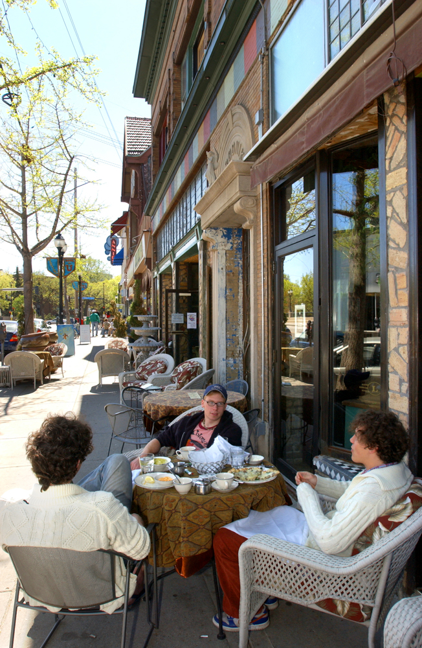

Slide 183
Wherever you travel you will not be far from other University of Minnesota alumni. You have a link to the U of M that cannot be broken, and we look forward to helping you on your journey. Best wishes and good luck as you set sail!
– Bob Snyder
‘68 Political Science

Slide 184
Chanelle Thomas BA Communication Studies Thank you U of M professors and advising staff. I finally made it!! Thank you hubby Michael for all of your support. Roni follow closely behind.

Slide 185
Tiffany Maixiong Vang BA Sociology of Law, Criminology, and Deviance

Slide 186
Evgen Vladyslavovych Vasko BS Economics

Slide 187
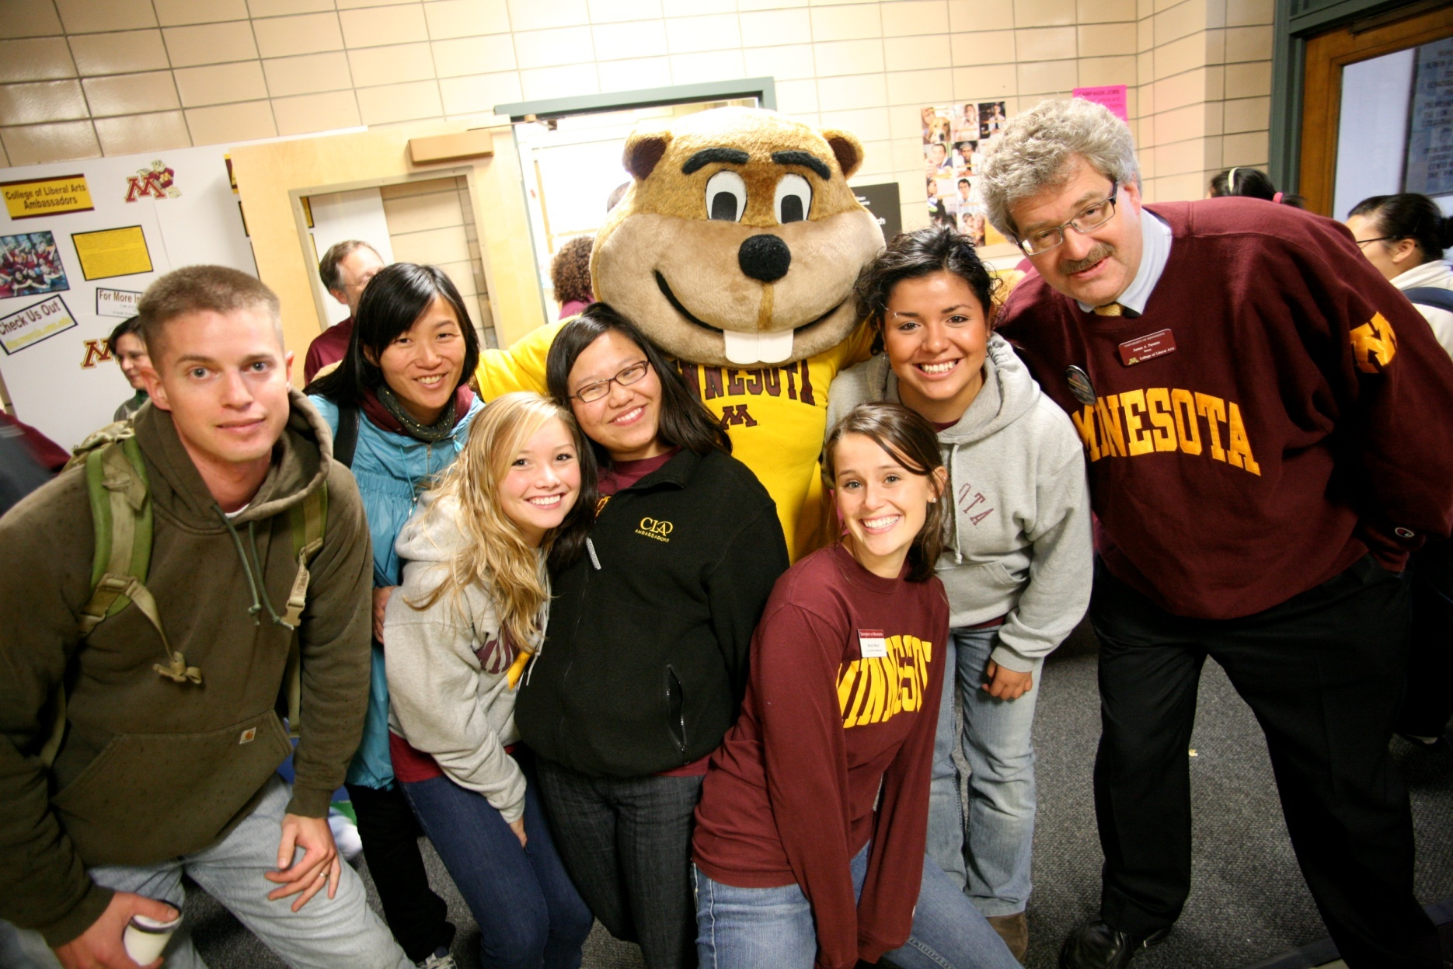

Slide 188
Life is indeed a marathon, not a sprint. When adversity comes your way look it squarely in the face and understand how you deal with it helps define your later success. Remember all the people and circumstances that have contributed to your success, as none of us get to where we are alone.
– Terry Addison
'71 African American & African Studies

Slide 189
Tanying Wang
BS Economics
BA Statistics

Slide 190
Yutong Wang BS Economics Congratulations to the class of 13! We did it! Now it is time to celebrate. Thanks Dad and Mom for all the support.

Slide 191
Xiaoying Wang
BS Economics
Thanks Mom and Dad for all the support! ~LOVE YOU ALL~

Slide 192
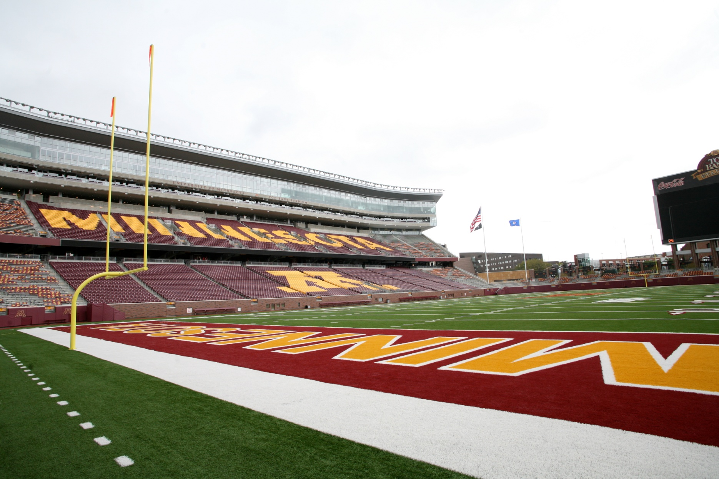

Slide 193
Make an effort to stay connected to any professors who've truly mentored you or made an impact. It is all too easy to lose touch but even 20 years down the road, you may want to reach back to them and say thanks.
– Beth Schommer
'93 Italian Area Studies

Slide 194
Yassmin Wazwaz BA Global Studies

Slide 195
Brandon R. Weeks BA Political Science

Slide 196
Caitlin Marie Whealon BIS Mass Communications, Art History and Management

Slide 198
Don't take yourself too seriously. The ability to laugh at your own foibles can carry you through some otherwise difficult moments.
– John R. Coleman
‘55 Zoology

Slide 199
Pa Nhia Xiong BA Global Studies Congrats class of '13! Good luck on your future endeavors! And a big thank you to all my loved ones and friends for supporting me!

Slide 200
Duoduo Xu
BS Economics

Slide 201
Chenchen Yang BS Economics

Slide 202
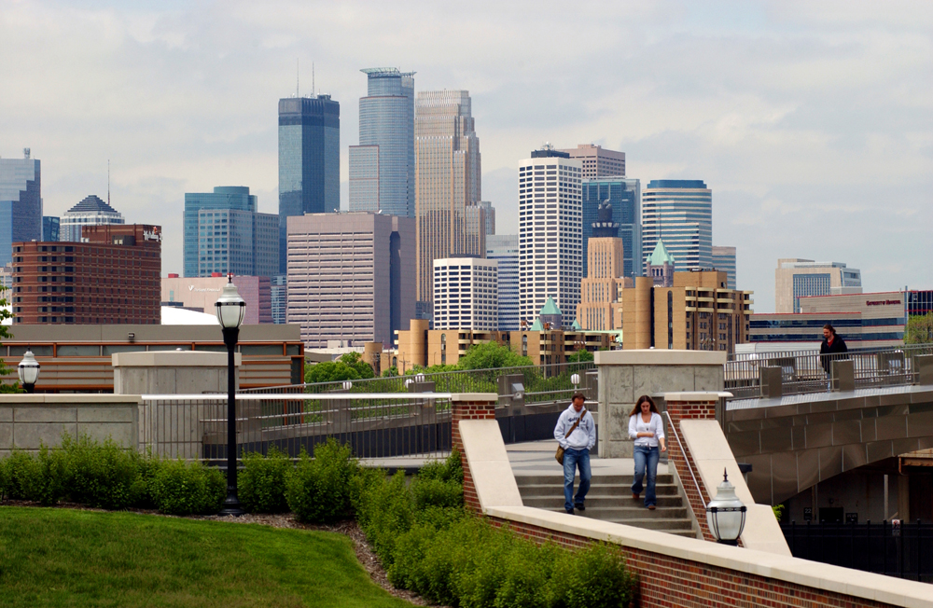

Slide 203
Sometimes the world throws unexpected difficulties in your path while at the same time giving you exciting new possibilities. If you are ready and stay positive, you will see the opportunities and benefit from them. If you become negative you will not see what is in front of you and miss what life has to offer you.
– Harold Beckala
‘70 Chemistry

Slide 204
Taylor Ann Yess BA Political Science Distinction Thanks to my family and friends for getting me to this point! I couldn't have done it without your love and support.

Slide 205
Xue Yu BA Economics

Slide 206
Ziqi Zang BS Economics High Distinction Thanks a million for helping me all the time!

Slide 208
Remember that it is not just about making a living, but making a world worth living in.
– Courtney Kuntz
‘06 Global Studies

Slide 209
Deidra Ann Zaske
BA Sociology of Law, Criminology, and Deviance

Slide 210
Shanqi Zhan
BS Economics
Congratulations to the class of 13! We did it!

Slide 211
Yimeng Zhang
BA Economics

Slide 212
